Slide 1

Lecture 1: A Brief Introduction to Continuous-Time Markov Models
Brian R. Moore Department of Evolution & Ecology University of California, Davis
CoME, 2019

Slide 2
Outline
I. A quick review of where we’ve been
Phylogenetic data & the tree-topology and branch-length parameters

Slide 3
Outline
I. A quick review of where we’ve been
Phylogenetic data & the tree-topology and branch-length parameters
II. A very Brief introduction to some basic probability theory
Making friends with some useful math

Slide 4
Outline
I. A quick review of where we’ve been
Phylogenetic data & the tree-topology and branch-length parameters
II. A very Brief introduction to some basic probability theory
Making friends with some useful math
III. Models of discrete character change
Continuous-time Markov what now?

Slide 5
Statistical Estimation of Phylogeny: An Outline
Generic statistical paradigm Statistical phylogenetic paradigm
pose a substantive question
what is the phylogeny of my study group?

Slide 6
Statistical Estimation of Phylogeny: An Outline
Generic statistical paradigm Statistical phylogenetic paradigm
pose a substantive question
what is the phylogeny of my study group?
develop a stochastic model with parameters that, if known, would answer the question
develop a phylogenetic model with a tree (and branch lengths) and a Markov model describing how traits change over the tree

Slide 7
Statistical Estimation of Phylogeny: An Outline
Generic statistical paradigm Statistical phylogenetic paradigm
pose a substantive question
what is the phylogeny of my study group?
develop a stochastic model with parameters that, if known, would answer the question
develop a phylogenetic model with a tree (and branch lengths) and a Markov model describing how traits change over the tree
collect observations that are informative about model parameters
assemble a data matrix (e.g., of DNA sequences) sampled from members of your study group

Slide 8
Statistical Estimation of Phylogeny: An Outline
Generic statistical paradigm Statistical phylogenetic paradigm
pose a substantive question
what is the phylogeny of my study group?
develop a stochastic model with parameters that, if known, would answer the question
develop a phylogenetic model with a tree (and branch lengths) and a Markov model describing how traits change over the tree
collect observations that are informative about model parameters
assemble a data matrix (e.g., of DNA sequences) sampled from members of your study group
find the best estimate of model parameters (by some means) conditioned on (i.e., given) the data at hand
find the best estimate of phylogeny (and other model parameters) using a likelihood-based method (maximum-likelihood or Bayesian inference)

Slide 9
Statistical Estimation of Phylogeny: An Outline
Inference Method
Data
Model
Parameter
Estimates
sequence
alignment
tree with
branch lengths
maximum likelihood
phylogeny & other model parameters
substitution
model
Bayesian inference

Slide 10
The Data: Nucleotide Sequences
I. The state space is comprised of the four nucleic acids
Purines
Pyrimidines
A (adenine)
A
C
C (cytosine)
G (guanine)
G
T
T (thymine)

Slide 11
The Data: Nucleotide Sequences
I. The state space is comprised of the four nucleic acids
Purines
Pyrimidines
A (adenine)
A
C
C (cytosine)
G (guanine)
G
T
T (thymine)
II. The sequences data are arranged in tables called data matrices
species 1 ACGCACCGGCGCAGTCA....
species 2 ACGTTCAGGCGGTCA....
species 3 ACGTTCACCGGCGCAGTCA....
species 4 ACGTTCACCCGCAGTCA....

Slide 12
The Data: Nucleotide Sequences
I. The state space is comprised of the four nucleic acids
Purines
Pyrimidines
A (adenine)
A
C
C (cytosine)
G (guanine)
G
T
T (thymine)
II. The sequences data are arranged in tables called data matrices
species 1 ACGCACCGGCGCAGTCA....
species 2 ACGTTCAGGCGGTCA....
species 3 ACGTTCACCGGCGCAGTCA....
species 4 ACGTTCACCCGCAGTCA....
III. The process of establishing homology is referred to as alignment
species 1 ACGCACCGGCGCAGTCA....
species 2 ACGTTCAGGCGGTCA....
species 3 ACGTTCACCGGCGCAGTCA....
species 4 ACGTTCACCCGCAGTCA....

Slide 13
The Data: Nucleotide Sequences
I. The state space is comprised of the four nucleic acids
Purines
Pyrimidines
A (adenine)
A
C
C (cytosine)
G (guanine)
G
T
T (thymine)
II. The sequences data are arranged in tables called data matrices
species 1 ACGCACCGGCGCAGTCA....
species 2 ACGTTCAGGCGGTCA....
species 3 ACGTTCACCGGCGCAGTCA....
species 4 ACGTTCACCCGCAGTCA....
III. The process of establishing homology is referred to as alignment
species 1 ACG--CACCGGCGCAGTCA....
species 2 ACGTTCA--GGCG--GTCA....
species 3 ACGTTCACCGGCGCAGTCA....
species 4 ACGTTCACC--CGCAGTCA....

Slide 14
Statistical Estimation of Phylogeny: An Outline
Inference Method
Data
Model
Parameter
Estimates
sequence
alignment
tree with
branch lengths
maximum likelihood
phylogeny & other model parameters
substitution
model
Bayesian inference

Slide 15
Statistical Estimation of Phylogeny: An Outline
Inference Method
Data
Model
Parameter
Estimates
sequence
alignment
tree with
branch lengths
maximum likelihood
phylogeny & other model parameters
substitution
model
Bayesian inference

Slide 16
The Model: Phylogeny Parameter
I. Phylogenies are estimates of genealogical (evolutionary) relationships
The topology specifies a nested set of common-ancestry relationships

Slide 17
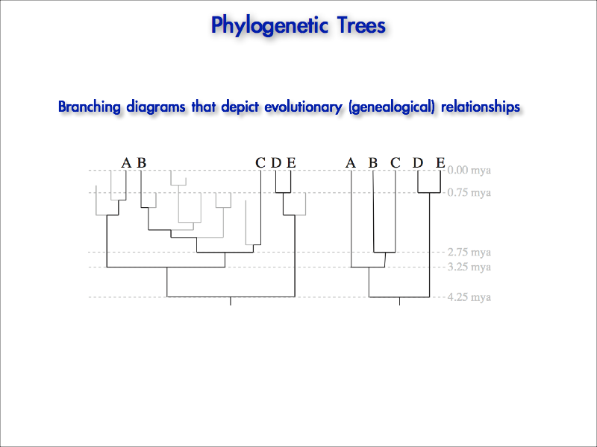
The Model: Phylogeny Parameter
I. Phylogenies are estimates of genealogical (evolutionary) relationships
The topology specifies a nested set of common-ancestry relationships

Slide 18
The Model: Phylogeny Parameter
I. Phylogenies are estimates of genealogical (evolutionary) relationships
The topology specifies a nested set of common-ancestry relationships
II. Phylogenies are unusual and difficult parameters to model
They are discrete in nature (directed acyclic binary graphs; aka ‘DAGS’)

Slide 19

The Model Dog: Louie Parameter

Slide 20

The Model Dog: Louie Parameter

Slide 21
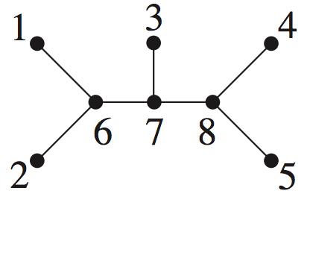
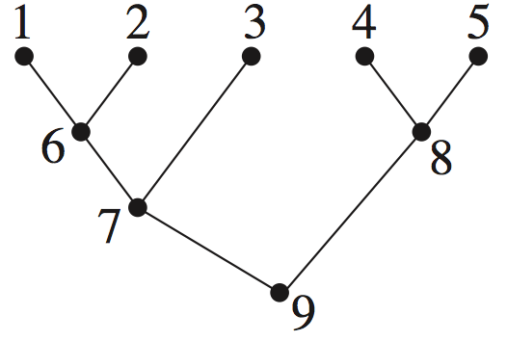
The Model: Phylogeny Parameter
Types of trees and their anatomy
unrooted tree
rooted tree
external
branch/edge

Slide 22
The Model: Phylogeny Parameter
Types of trees and their anatomy
unrooted tree
rooted tree
internal
branch/edge

Slide 23
The Model: Phylogeny Parameter
Types of trees and their anatomy
unrooted tree
rooted tree
external
node/vertex
(leaf/tip)

Slide 24
The Model: Phylogeny Parameter
Types of trees and their anatomy
unrooted tree
rooted tree
internal
node/vertex
(MRCA)

Slide 25
The Model: Phylogeny Parameter
Types of trees and their anatomy
unrooted tree
rooted tree
(virtual) root node

Slide 26
The Model: Phylogeny Parameter
Types of trees and their anatomy
unrooted tree
rooted tree
Phylogenies fully specify evolutionary relationships among a set of species.

Slide 27
The Model: Phylogeny Parameter
Types of trees and their anatomy
unrooted tree
rooted tree
Phylogenies fully specify evolutionary relationships among a set of species.
Unrooted trees constrain but do not fully specify evolutionary relationships.

Slide 28
The Model: Phylogeny Parameter
Types of trees and their anatomy
unrooted tree
rooted tree
Phylogenies fully specify evolutionary relationships among a set of species.
Unrooted trees constrain but do not fully specify evolutionary relationships.

Slide 29
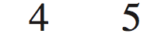
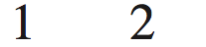
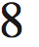
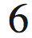
The Model: Phylogeny Parameter
Types of trees and their anatomy
unrooted tree
rooted tree
Phylogenies fully specify evolutionary relationships among a set of species.
Unrooted trees constrain but do not fully specify evolutionary relationships.
So, unrooted trees are not phylogenies.

Slide 30
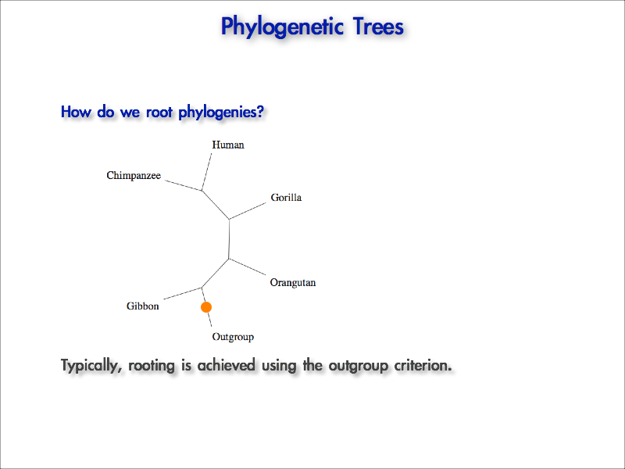
The Model: Phylogeny Parameter
Transforming an unrooted tree into a phylogeny
Typically, we root unrooted trees using the outgroup method

Slide 31
The Model: Phylogeny Parameter
How many nodes and branches are here?
unrooted tree
rooted tree
number of nodes
NU (s) = 2s – 2
NR (s) = 2s – 1

Slide 32
The Model: Phylogeny Parameter
How many nodes and branches are here?
unrooted tree
rooted tree
number of nodes
NU (s) = 2s – 2
NR (s) = 2s – 1
number of branches
BU (s) = 2s – 3
BR (s) = 2s – 2

Slide 33
The Model: Phylogeny Parameter
How many unrooted trees are there?
1
2

Slide 34
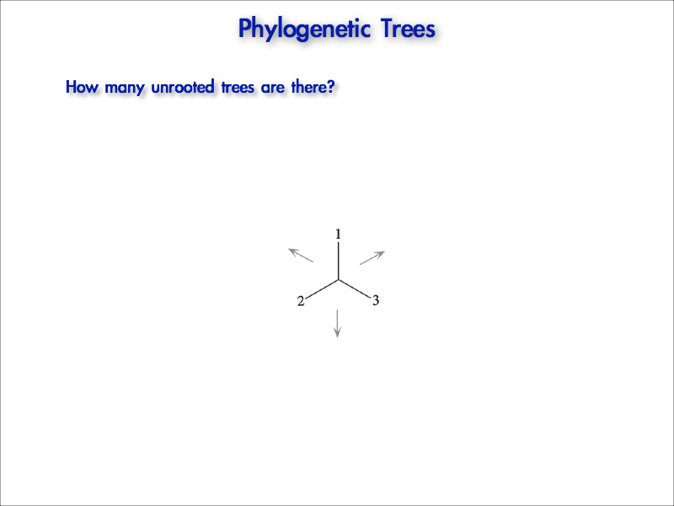
The Model: Phylogeny Parameter
How many unrooted trees are there?

Slide 35
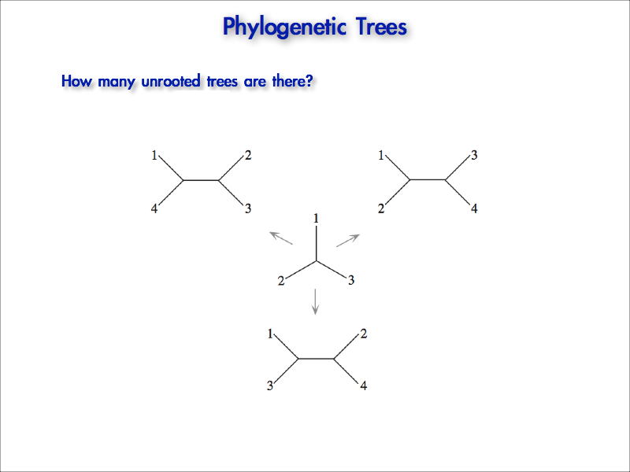
The Model: Phylogeny Parameter
How many unrooted trees are there?

Slide 36
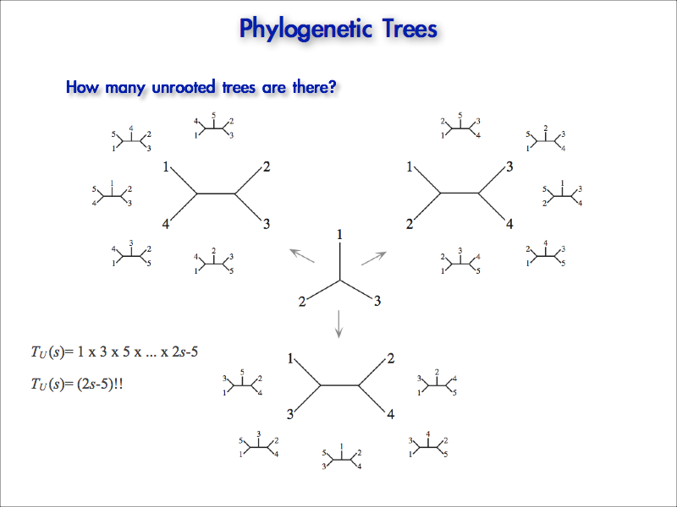
The Model: Phylogeny Parameter
How many unrooted trees are there?

Slide 37
The Model: Phylogeny Parameter
How many unrooted trees are there?

Slide 38
The Model: Phylogeny Parameter
I. Phylogenies are estimates of genealogical (evolutionary) relationships
The topology specifies a nested set of common-ancestry relationships
II. Phylogenies are unusual and difficult parameters to model
They are discrete in nature (directed acyclic binary graphs; aka ‘DAGS’)
The combinatorics are such that the solution space can be vast

Slide 39
The Model: Phylogeny Parameter
How many unrooted trees are there?
TU (s) = 1 ξ 3 ξ 5 … ξ (2s – 5)

Slide 40
The Model: Phylogeny Parameter
How many unrooted trees are there?
TU (s) = 1 ξ 3 ξ 5 … ξ (2s – 5)
TU (s) = (2s – 5)!!

Slide 41
The Model: Phylogeny Parameter
How many rooted trees are there?
unrooted tree
rooted tree
number of nodes
NU (s) = 2s – 2
NR (s) = 2s – 1
number of branches
BU (s) = 2s – 3
BR (s) = 2s – 2
(i.e., the number of places to add a root node)

Slide 42
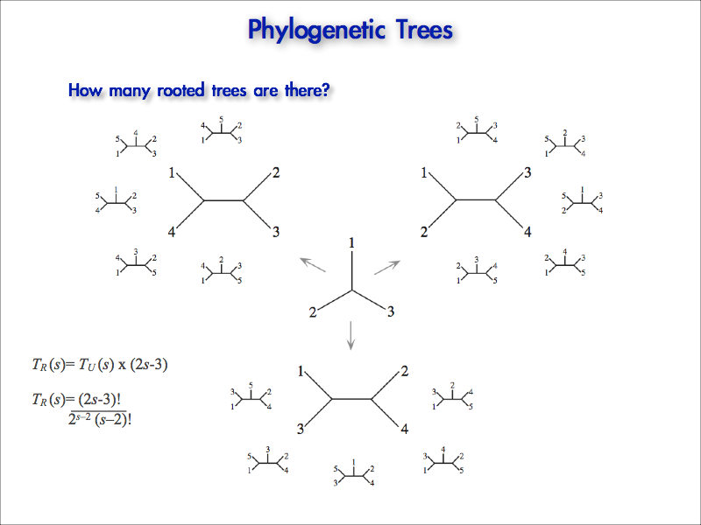
The Model: Phylogeny Parameter
How many rooted trees are there?
number unrooted trees
TR (s) = TU (s) ξ (2s – 3)

Slide 43
The Model: Phylogeny Parameter
How many rooted trees are there?
number unrooted trees
TR (s) = TU (s) ξ (2s – 3)
number of places to add a root node

Slide 44
The Model: Phylogeny Parameter
How many rooted trees are there?
TR (s) = TU (s) ξ (2s – 3)
TR (s) = (2s – 3)! 2^{s – 2}(s – 2)!

Slide 45
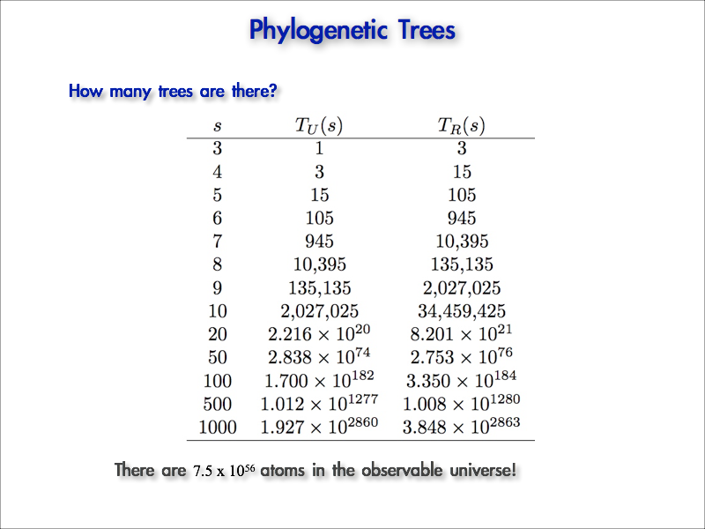
The Model: Phylogeny Parameter
How many trees are there?
45 species

Slide 46
The Model: Phylogeny Parameter
I. Phylogenies are estimates of genealogical (evolutionary) relationships
The topology specifies a nested set of common-ancestry relationships
II. Phylogenies are unusual and difficult parameters to model
They are discrete in nature (directed acyclic binary graphs; aka ‘DAGS’)
The combinatorics are such that the solution space can be vast
III. The branches of trees may reflect different quantities
The type of phylogeny depends on the nature of the branch lengths it depicts

Slide 47
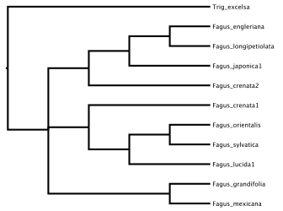
The Model: Phylogeny Parameter
I. Phylogenies are estimates of genealogical (evolutionary) relationships
The topology specifies a nested set of common-ancestry relationships
II. Phylogenies are unusual and difficult parameters to model
They are discrete in nature (directed acyclic binary graphs; aka ‘DAGS’)
The combinatorics are such that the solution space can be vast
III. The branches of trees may reflect different quantities
The type of phylogeny depends on the nature of the branch lengths it depicts
Cladogram: arbitrary branch lengths

Slide 48
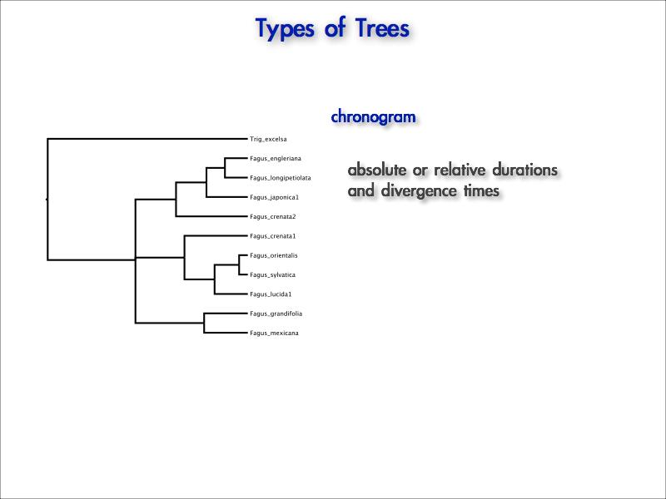
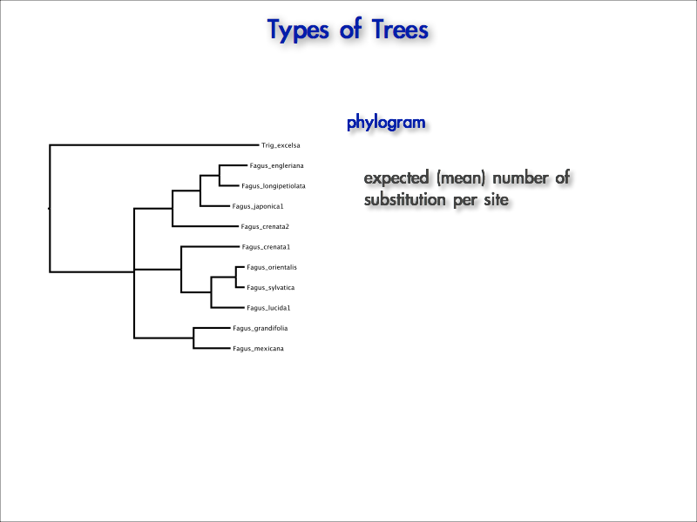
The Model: Phylogeny Parameter
I. Phylogenies are estimates of genealogical (evolutionary) relationships
The topology specifies a nested set of common-ancestry relationships
II. Phylogenies are unusual and difficult parameters to model
They are discrete in nature (directed acyclic binary graphs; aka ‘DAGS’)
The combinatorics are such that the solution space can be vast
III. The branches of trees may reflect different quantities
The type of phylogeny depends on the nature of the branch lengths it depicts
Phylogram: expected number of substitutions/site

Slide 49
The Model: Phylogeny Parameter
I. Phylogenies are estimates of genealogical (evolutionary) relationships
The topology specifies a nested set of common-ancestry relationships
II. Phylogenies are unusual and difficult parameters to model
They are discrete in nature (directed acyclic binary graphs; aka ‘DAGS’)
The combinatorics are such that the solution space can be vast
III. The branches of trees may reflect different quantities
The type of phylogeny depends on the nature of the branch lengths it depicts
Chronogram: relative/absolute branch durations and node ages

Slide 50
Outline
I. A quick review of where we’ve been
Phylogenetic data & the tree-topology and branch-length parameters
II. A very Brief introduction to some basic probability theory
Making friends with some useful math
III. Models of discrete character change
Continuous-time Markov what now?

Slide 51
Outline
I. A quick review of where we’ve been
Phylogenetic data & the tree-topology and branch-length parameters
II. A very Brief introduction to some basic probability theory
Making friends with some useful math
III. Models of discrete character change
Continuous-time Markov what now?

Slide 52
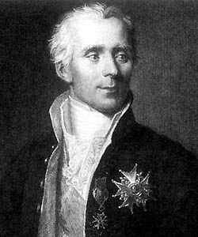
A Brief Probabilistic Digression
Some probability concepts…
“Probability theory is nothing but common sense reduced to calculation.” Pierre-Simon Laplace (1799)

Slide 53




A Brief Probabilistic Digression
Some probability concepts…
Imagine that we make a table of observations on nationality and gender for a sample of students.
 |  |  | Σ
 | 23/40 | 2/40 | 25/40
 | 12/40 | 3/40 | 15/40
Σ | 35/40 | 5/40 | 40/40

Slide 54

A Brief Probabilistic Digression
Some probability concepts…
Imagine that we make a table of observations on nationality and gender for a sample of students.
 |  |  | Σ
 | 23/40 | 2/40 | 25/40
 | 12/40 | 3/40 | 15/40
Σ | 35/40 | 5/40 | 40/40
PSA: Hair products and cologne are extremely flammable!!

Slide 55
A Brief Probabilistic Digression
Conditional Probability
The probability of observing A given that B has occurred, Pr(A⏐B), is just the fraction of cases in which B occurs, Pr(B), that A also occurs, Pr(A,B).
 |  |  | Σ
 | 23/40 | 2/40 | 25/40
 | 12/40 | 3/40 | 15/40
Σ | 35/40 | 5/40 | 40/40
What is the probability that a student is Canadian, given that he is male?

Slide 56
A Brief Probabilistic Digression
Conditional Probability
The probability of observing A given that B has occurred, Pr(A⏐B), is just the fraction of cases in which B occurs, Pr(B), that A also occurs, Pr(A,B).
Pr(CDN|male) = Pr(CDN,male)
 |  |  | Σ
 | 23/40 | 2/40 | 25/40
 | 12/40 | 3/40 | 15/40
Σ | 35/40 | 5/40 | 40/40
Pr(male)
What is the probability that a student is Canadian, given that he is male?

Slide 57
A Brief Probabilistic Digression
Conditional Probability
The probability of observing A given that B has occurred, Pr(A⏐B), is just the fraction of cases in which B occurs, Pr(B), that A also occurs, Pr(A,B).
Pr(CDN|male) = Pr(CDN,male)
 |  |  | Σ
 | 23/40 | 2/40 | 25/40
 | 12/40 | 3/40 | 15/40
Σ | 35/40 | 5/40 | 40/40
Pr(male)
= 3/40
What is the probability that a student is Canadian, given that he is male?

Slide 58
A Brief Probabilistic Digression
Conditional Probability
The probability of observing A given that B has occurred, Pr(A⏐B), is just the fraction of cases in which B occurs, Pr(B), that A also occurs, Pr(A,B).
Pr(CDN|male) = Pr(CDN,male)
 |  |  | Σ
 | 23/40 | 2/40 | 25/40
 | 12/40 | 3/40 | 15/40
Σ | 35/40 | 5/40 | 40/40
Pr(male)
=
3/40
15/40
What is the probability that a student is Canadian, given that he is male?

Slide 59
A Brief Probabilistic Digression
Conditional Probability
The probability of observing A given that B has occurred, Pr(A⏐B), is just the fraction of cases in which B occurs, Pr(B), that A also occurs, Pr(A,B).
Pr(CDN|male) = Pr(CDN,male)
 |  |  | Σ
 | 23/40 | 2/40 | 25/40
 | 12/40 | 3/40 | 15/40
Σ | 35/40 | 5/40 | 40/40
Pr(male)
=
3/40
= 0.2
15/40
What is the probability that a student is Canadian, given that he is male?

Slide 60
A Brief Probabilistic Digression
Joint Probability
The probability of observing A and B, Pr(A,B), can be determined by rearranging the expression for conditional likelihood.
Pr(A|B) = Pr(A,B)
 |  |  | Σ
 | 23/40 | 2/40 | 25/40
 | 12/40 | 3/40 | 15/40
Σ | 35/40 | 5/40 | 40/40
Pr(B)

Slide 61
A Brief Probabilistic Digression
Joint Probability
The probability of observing A and B, Pr(A,B), can be determined by rearranging the expression for conditional likelihood.
Pr(B)
Pr(A|B) = Pr(A,B)
 |  |  | Σ
 | 23/40 | 2/40 | 25/40
 | 12/40 | 3/40 | 15/40
Σ | 35/40 | 5/40 | 40/40

Slide 62
A Brief Probabilistic Digression
Joint Probability
The probability of observing A and B, Pr(A,B), can be determined by rearranging the expression for conditional likelihood.
Pr(A,B) = Pr(A|B) Pr(B)
 |  |  | Σ
 | 23/40 | 2/40 | 25/40
 | 12/40 | 3/40 | 15/40
Σ | 35/40 | 5/40 | 40/40

Slide 63
A Brief Probabilistic Digression
Joint Probability
The probability of observing A and B, Pr(A,B), can be determined by rearranging the expression for conditional likelihood.
Pr(A,B) = Pr(A|B) Pr(B)
 |  |  | Σ
 | 23/40 | 2/40 | 25/40
 | 12/40 | 3/40 | 15/40
Σ | 35/40 | 5/40 | 40/40
= Pr(B|A) Pr(A)

Slide 64
A Brief Probabilistic Digression
Joint Probability
The probability of observing A and B, Pr(A,B), can be determined by rearranging the expression for conditional likelihood.
Pr(A,B) = Pr(A|B) Pr(B)
 |  |  | Σ
 | 23/40 | 2/40 | 25/40
 | 12/40 | 3/40 | 15/40
Σ | 35/40 | 5/40 | 40/40
= Pr(B|A) Pr(A)
Pr(CDN,male) = Pr(CDN|male) Pr(male)
What is the probability that a student is both male and Canadian?

Slide 65
A Brief Probabilistic Digression
Joint Probability
The probability of observing A and B, Pr(A,B), can be determined by rearranging the expression for conditional likelihood.
Pr(A,B) = Pr(A|B) Pr(B)
 |  |  | Σ
 | 23/40 | 2/40 | 25/40
 | 12/40 | 3/40 | 15/40
Σ | 35/40 | 5/40 | 40/40
= Pr(B|A) Pr(A)
Pr(CDN,male) = Pr(CDN|male) Pr(male)
=
3/40
15/40
What is the probability that a student is both male and Canadian?

Slide 66
A Brief Probabilistic Digression
Joint Probability
The probability of observing A and B, Pr(A,B), can be determined by rearranging the expression for conditional likelihood.
Pr(A,B) = Pr(A|B) Pr(B)
 |  |  | Σ
 | 23/40 | 2/40 | 25/40
 | 12/40 | 3/40 | 15/40
Σ | 35/40 | 5/40 | 40/40
= Pr(B|A) Pr(A)
Pr(CDN,male) = Pr(CDN|male) Pr(male)
=
3/40
15/40
What is the probability that a student is both male and Canadian?

Slide 67
A Brief Probabilistic Digression
Joint Probability
The probability of observing A and B, Pr(A,B), can be determined by rearranging the expression for conditional likelihood.
Pr(A,B) = Pr(A|B) Pr(B)
 |  |  | Σ
 | 23/40 | 2/40 | 25/40
 | 12/40 | 3/40 | 15/40
Σ | 35/40 | 5/40 | 40/40
= Pr(B|A) Pr(A)
Pr(CDN,male) = Pr(CDN|male) Pr(male)
=
3/15
What is the probability that a student is both male and Canadian?

Slide 68
A Brief Probabilistic Digression
Joint Probability
The probability of observing A and B, Pr(A,B), can be determined by rearranging the expression for conditional likelihood.
Pr(A,B) = Pr(A|B) Pr(B)
 |  |  | Σ
 | 23/40 | 2/40 | 25/40
 | 12/40 | 3/40 | 15/40
Σ | 35/40 | 5/40 | 40/40
= Pr(B|A) Pr(A)
Pr(CDN,male) = Pr(CDN|male) Pr(male)
=
3/15 ξ 15/40
What is the probability that a student is both male and Canadian?

Slide 69
A Brief Probabilistic Digression
Joint Probability
The probability of observing A and B, Pr(A,B), can be determined by rearranging the expression for conditional likelihood.
Pr(A,B) = Pr(A|B) Pr(B)
 |  |  | Σ
 | 23/40 | 2/40 | 25/40
 | 12/40 | 3/40 | 15/40
Σ | 35/40 | 5/40 | 40/40
= Pr(B|A) Pr(A)
Pr(CDN,male) = Pr(CDN|male) Pr(male)
=
3/15 ξ 15/40
=
3/40 = 0.075
What is the probability that a student is both male and Canadian?

Slide 70
A Brief Probabilistic Digression
Joint Probability
The probability of observing A and B, Pr(A,B), can be determined by rearranging the expression for conditional likelihood.
Pr(A,B) = Pr(A|B) Pr(B)
 |  |  | Σ
 | 23/40 | 2/40 | 25/40
 | 12/40 | 3/40 | 15/40
Σ | 35/40 | 5/40 | 40/40
= Pr(B|A) Pr(A)
Pr(CDN,male) = Pr(CDN|male) Pr(male)
=
3/15 ξ 15/40
=
3/40 = 0.075
Pr(CDN,male) = Pr(male|CDN) Pr(CDN)
What is the probability that a student is both male and Canadian?

Slide 71
A Brief Probabilistic Digression
Joint Probability
The probability of observing A and B, Pr(A,B), can be determined by rearranging the expression for conditional likelihood.
Pr(A,B) = Pr(A|B) Pr(B)
 |  |  | Σ
 | 23/40 | 2/40 | 25/40
 | 12/40 | 3/40 | 15/40
Σ | 35/40 | 5/40 | 40/40
= Pr(B|A) Pr(A)
Pr(CDN,male) = Pr(CDN|male) Pr(male)
=
3/15 ξ 15/40
=
3/40 = 0.075
Pr(CDN,male) = Pr(male|CDN) Pr(CDN)
= 3/40
What is the probability that a student is both male and Canadian?

Slide 72
A Brief Probabilistic Digression
Joint Probability
The probability of observing A and B, Pr(A,B), can be determined by rearranging the expression for conditional likelihood.
Pr(A,B) = Pr(A|B) Pr(B)
 |  |  | Σ
 | 23/40 | 2/40 | 25/40
 | 12/40 | 3/40 | 15/40
Σ | 35/40 | 5/40 | 40/40
= Pr(B|A) Pr(A)
Pr(CDN,male) = Pr(CDN|male) Pr(male)
=
3/15 ξ 15/40
=
3/40 = 0.075
Pr(CDN,male) = Pr(male|CDN) Pr(CDN)
=
3/40
5/40
What is the probability that a student is both male and Canadian?

Slide 73
A Brief Probabilistic Digression
Joint Probability
The probability of observing A and B, Pr(A,B), can be determined by rearranging the expression for conditional likelihood.
Pr(A,B) = Pr(A|B) Pr(B)
 |  |  | Σ
 | 23/40 | 2/40 | 25/40
 | 12/40 | 3/40 | 15/40
Σ | 35/40 | 5/40 | 40/40
= Pr(B|A) Pr(A)
Pr(CDN,male) = Pr(CDN|male) Pr(male)
=
3/15 ξ 15/40
=
3/40 = 0.075
Pr(CDN,male) = Pr(male|CDN) Pr(CDN)
= 3/5
What is the probability that a student is both male and Canadian?

Slide 74
A Brief Probabilistic Digression
Joint Probability
The probability of observing A and B, Pr(A,B), can be determined by rearranging the expression for conditional likelihood.
Pr(A,B) = Pr(A|B) Pr(B)
 |  |  | Σ
 | 23/40 | 2/40 | 25/40
 | 12/40 | 3/40 | 15/40
Σ | 35/40 | 5/40 | 40/40
= Pr(B|A) Pr(A)
Pr(CDN,male) = Pr(CDN|male) Pr(male)
=
3/15 ξ 15/40
=
3/40 = 0.075
Pr(CDN,male) = Pr(male|CDN) Pr(CDN)
= 3/5 ξ 5/40
What is the probability that a student is both male and Canadian?

Slide 75
A Brief Probabilistic Digression
Joint Probability
The probability of observing A and B, Pr(A,B), can be determined by rearranging the expression for conditional likelihood.
Pr(A,B) = Pr(A|B) Pr(B)
 |  |  | Σ
 | 23/40 | 2/40 | 25/40
 | 12/40 | 3/40 | 15/40
Σ | 35/40 | 5/40 | 40/40
= Pr(B|A) Pr(A)
Pr(CDN,male) = Pr(CDN|male) Pr(male)
=
3/15 ξ 15/40
=
3/40 = 0.075
Pr(CDN,male) = Pr(male|CDN) Pr(CDN)
= 3/5 ξ 5/40
=
3/40 = 0.075
What is the probability that a student is both male and Canadian?

Slide 76
A Brief Probabilistic Digression
Marginal Probability
The unconditional probability of an observation A or B.
 |  |  | Σ
 | 23/40 | 2/40 | 25/40
 | 12/40 | 3/40 | 15/40
Σ | 35/40 | 5/40 | 40/40
What is the marginal probability of being Canadian?
5/40
marginalize over gender

Slide 77
A Brief Probabilistic Digression
Marginal Probability
The unconditional probability of an observation A or B.
 |  |  | Σ
 | 23/40 | 2/40 | 25/40
 | 12/40 | 3/40 | 15/40
Σ | 35/40 | 5/40 | 40/40
What is the marginal probability of being male?
15/40
marginalize over nationality

Slide 78
A Brief Probabilistic Digression
Marginal Probability
The unconditional probability of an observation A or B.
Pr(male) = 12/40
 |  |  | Σ
 | 23/40 | 2/40 | 25/40
 | 12/40 | 3/40 | 15/40
Σ | 35/40 | 5/40 | 40/40
What is the marginal probability of being male?

Slide 79
A Brief Probabilistic Digression
Marginal Probability
The unconditional probability of an observation A or B.
Pr(male) = 12/40 + 3/40
 |  |  | Σ
 | 23/40 | 2/40 | 25/40
 | 12/40 | 3/40 | 15/40
Σ | 35/40 | 5/40 | 40/40
What is the marginal probability of being male?

Slide 80
A Brief Probabilistic Digression
Marginal Probability
The unconditional probability of an observation A or B.
Pr(male) = 12/40 + 3/40
 |  |  | Σ
 | 23/40 | 2/40 | 25/40
 | 12/40 | 3/40 | 15/40
Σ | 35/40 | 5/40 | 40/40
Pr(male) = 15/40
What is the marginal probability of being male?

Slide 81
A Brief Probabilistic Digression
Marginal Probability
The unconditional probability of an observation A or B.
Pr(male) = 12/40 + 3/40
 |  |  | Σ
 | 23/40 | 2/40 | 25/40
 | 12/40 | 3/40 | 15/40
Σ | 35/40 | 5/40 | 40/40
Pr(male) = 15/40 = 0.375
What is the marginal probability of being male?

Slide 82
A Brief Probabilistic Digression
Marginal Probability
The unconditional probability of an observation A or B.
 |  |  | Σ
 | 23/40 | 2/40 | 25/40
 | 12/40 | 3/40 | 15/40
Σ | 35/40 | 5/40 | 40/40
What is the marginal probability of being Canadian?

Slide 83
A Brief Probabilistic Digression
Marginal Probability
The unconditional probability of an observation A or B.
Pr(CDN) = 2/40
 |  |  | Σ
 | 23/40 | 2/40 | 25/40
 | 12/40 | 3/40 | 15/40
Σ | 35/40 | 5/40 | 40/40
What is the marginal probability of being Canadian?

Slide 84
A Brief Probabilistic Digression
Marginal Probability
The unconditional probability of an observation A or B.
Pr(CDN) = 2/40 + 3/40
 |  |  | Σ
 | 23/40 | 2/40 | 25/40
 | 12/40 | 3/40 | 15/40
Σ | 35/40 | 5/40 | 40/40
What is the marginal probability of being Canadian?

Slide 85
A Brief Probabilistic Digression
Marginal Probability
The unconditional probability of an observation A or B.
Pr(CDN) = 2/40 + 3/40
 |  |  | Σ
 | 23/40 | 2/40 | 25/40
 | 12/40 | 3/40 | 15/40
Σ | 35/40 | 5/40 | 40/40
Pr(male) = 5/40
What is the marginal probability of being Canadian?

Slide 86
A Brief Probabilistic Digression
Marginal Probability
The unconditional probability of an observation A or B.
Pr(CDN) = 2/40 + 3/40
 |  |  | Σ
 | 23/40 | 2/40 | 25/40
 | 12/40 | 3/40 | 15/40
Σ | 35/40 | 5/40 | 40/40
Pr(male) = 5/40 = 0.375
What is the marginal probability of being Canadian?

Slide 87
A Brief Probabilistic Digression
The Law of Total Probability
The unconditional probabilities sum to unity.
 |  |  | Σ
 | 23/40 | 2/40 | 25/40
 | 12/40 | 3/40 | 15/40
Σ | 35/40 | 5/40 | 40/40
What is the probability of all possible combinations of gender/nationality?

Slide 88
A Brief Probabilistic Digression
The Law of Total Probability
The unconditional probabilities sum to unity.
Pr(total) = 25/40 + 15/40 = 1
 |  |  | Σ
 | 23/40 | 2/40 | 25/40
 | 12/40 | 3/40 | 15/40
Σ | 35/40 | 5/40 | 40/40
What is the probability of all possible combinations of gender/nationality?

Slide 89
A Brief Probabilistic Digression
The Law of Total Probability
The unconditional probabilities sum to unity.
Pr(total) = 25/40 + 15/40 = 1
 |  |  | Σ
 | 23/40 | 2/40 | 25/40
 | 12/40 | 3/40 | 15/40
Σ | 35/40 | 5/40 | 40/40
Pr(total) = 35/40 + 5/40 = 1
What is the probability of all possible combinations of gender/nationality?

Slide 90
A Brief Probabilistic Digression
Statistical Independence
The two events are independent if the product of their marginal probabilities equals the joint probability of those two events.
Pr(CDN,male) ?= Pr(CDN) Pr(male)
 |  |  | Σ
 | 23/40 | 2/40 | 25/40
 | 12/40 | 3/40 | 15/40
Σ | 35/40 | 5/40 | 40/40
Are the probabilities of being male and Canadian independent?

Slide 91
A Brief Probabilistic Digression
Statistical Independence
The two events are independent if the product of their marginal probabilities equals the joint probability of those two events.
Pr(CDN,male) ?= Pr(CDN) Pr(male)
 |  |  | Σ
 | 23/40 | 2/40 | 25/40
 | 12/40 | 3/40 | 15/40
Σ | 35/40 | 5/40 | 40/40
3/40
Are the probabilities of being male and Canadian independent?

Slide 92
A Brief Probabilistic Digression
Statistical Independence
The two events are independent if the product of their marginal probabilities equals the joint probability of those two events.
Pr(CDN,male) ?= Pr(CDN) Pr(male)
 |  |  | Σ
 | 23/40 | 2/40 | 25/40
 | 12/40 | 3/40 | 15/40
Σ | 35/40 | 5/40 | 40/40
3/40 ?= 5/40
Are the probabilities of being male and Canadian independent?

Slide 93
A Brief Probabilistic Digression
Statistical Independence
The two events are independent if the product of their marginal probabilities equals the joint probability of those two events.
Pr(CDN,male) ?= Pr(CDN) Pr(male)
 |  |  | Σ
 | 23/40 | 2/40 | 25/40
 | 12/40 | 3/40 | 15/40
Σ | 35/40 | 5/40 | 40/40
3/40 ?= 5/40 ξ 15/40
Are the probabilities of being male and Canadian independent?

Slide 94
A Brief Probabilistic Digression
Statistical Independence
The two events are independent if the product of their marginal probabilities equals the joint probability of those two events.
Pr(CDN,male) ?= Pr(CDN) Pr(male)
 |  |  | Σ
 | 23/40 | 2/40 | 25/40
 | 12/40 | 3/40 | 15/40
Σ | 35/40 | 5/40 | 40/40
3/40 ?= 5/40 ξ 15/40
0.075 ≠ 0.047
Are the probabilities of being male and Canadian independent?

Slide 95

An Overview of Phylogenetic Inference
WE NOW RETURN TO OUR REGULARLY SCHEDULED PROGRAM

Slide 96
Outline
I. A quick review of where we’ve been
Phylogenetic data & the tree-topology and branch-length parameters
II. A very Brief introduction to some basic probability theory
Making friends with some useful math
III. Models of discrete character change
Continuous-time Markov what now?

Slide 97
Outline
I. A quick review of where we’ve been
Phylogenetic data & the tree-topology and branch-length parameters
II. A very Brief introduction to some basic probability theory
Making friends with some useful math
III. Models of discrete character change
Continuous-time Markov what now?

Slide 98
Statistical Estimation of Phylogeny: An Outline
Inference Method
Data
Model
Parameter
Estimates
sequence
alignment
tree with
branch lengths
maximum likelihood
phylogeny & other model parameters
substitution
model
Bayesian inference

Slide 99
Statistical Estimation of Phylogeny: An Outline
Inference Method
Data
Model
Parameter
Estimates
sequence
alignment
tree with
branch lengths
maximum likelihood
phylogeny & other model parameters
substitution
model
Bayesian inference

Slide 100
Stochastic Models of Nucleotide Substitution
Species
Sequence data
Species I GCG--CACCGGCGCAGTCA....
Species II GCGTTCA--GGCG--GTCA....
Species III ACGTTCACCGGCGCAGTCA....

Slide 101
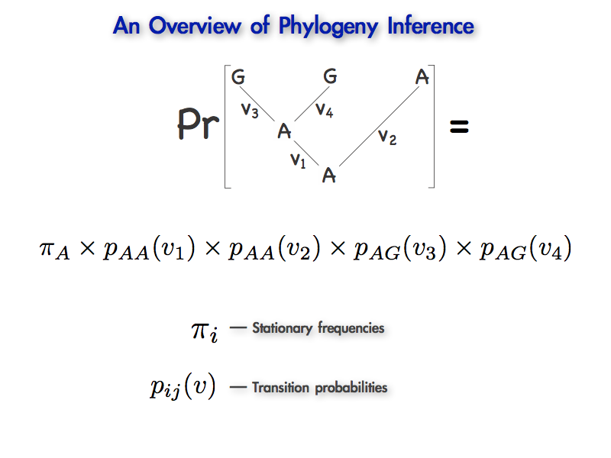
Stochastic Models of Nucleotide Substitution
I
II
III
Comic Sans

Slide 102
Stochastic Models of Nucleotide Substitution
I
II
III

Slide 103
Stochastic Models of Nucleotide Substitution
I
II
III

Slide 104
Stochastic Models of Nucleotide Substitution
I
II
III

Slide 105
Stochastic Models of Nucleotide Substitution
I
II
III

Slide 106
Stochastic Models of Nucleotide Substitution
I
II
III

Slide 107
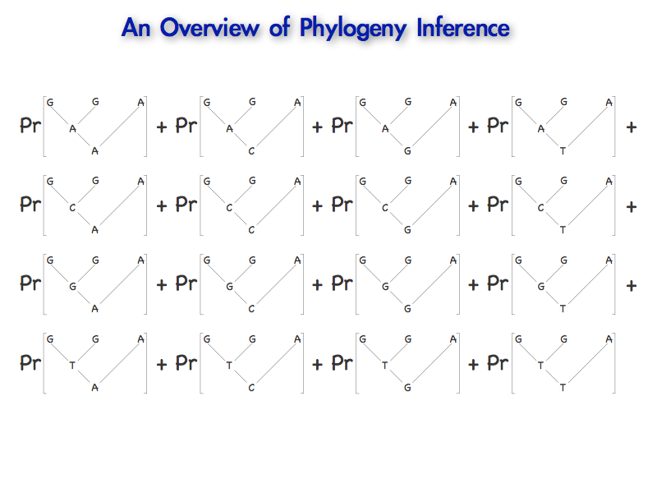
Stochastic Models of Nucleotide Substitution

Slide 108
Stochastic Models of Nucleotide Substitution
j
i
Stationary frequencies
Transition probabilities

Slide 109
Stochastic Models of Nucleotide Substitution
j
i
Stationary frequencies
Transition probabilities

Slide 110
Stochastic Models of Nucleotide Substitution
j
i
Stationary frequencies
Transition probabilities

Slide 111
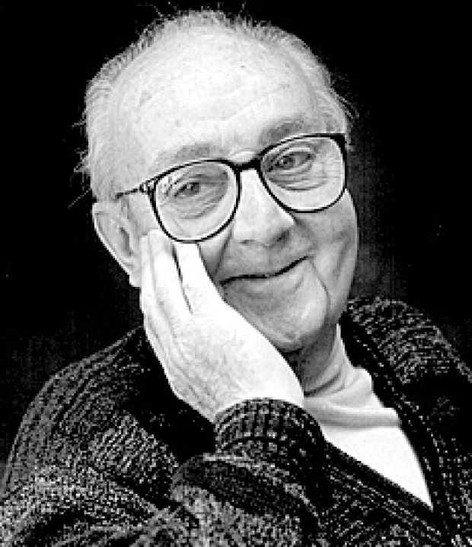
Stochastic Models of Nucleotide Substitution
“All models are wrong, but some are useful” George E. P. Box (1976)
George Box

Slide 112
Stochastic Models of Nucleotide Substitution
“All models are wrong, but some are useful” George E. P. Box (1976)
George Box
R. A. Fisher

Slide 113

Stochastic Models of Nucleotide Substitution
“All models are wrong, but some are useful” George E. P. Box (1976)
Donald Sutherland
R. A. Fisher

Slide 114
Stochastic Models of Nucleotide Substitution
Continuous-time Markov Chains (CTMC)
Evolution of discrete traits (e.g., substitution models, morphological models)

Slide 115
Stochastic Models of Nucleotide Substitution
Continuous-time Markov Chains (CTMC)
Evolution of discrete traits (e.g., substitution models, morphological models)
Diffusion model
Evolution of continuous traits (e.g., Brownian, OU, Levey process models)

Slide 116
Stochastic Models of Nucleotide Substitution
Models describe changes in the nucleotide sites at the species level
We are (generally) not trying to model the dynamics of allele frequencies in populations
CACCGGCGC
CACCTGCGC
CACCGGCGC

Slide 117
Stochastic Models of Nucleotide Substitution
Models describe changes in the nucleotide sites at the species level
We are (generally) not trying to model the dynamics of allele frequencies in populations
CACCGGCGC
CACCTGCGC
CACCGGCGC
We are modeling the process of nucleotide substitution, which describes the outcome of the mutation and fixation processes within populations

Slide 118
Stochastic Models of Nucleotide Substitution
Continuous-time Markov Models
Character change (nucleotide substitution) is modeled as a continuous-time Markov chain (CTMC)

Slide 119
Stochastic Models of Nucleotide Substitution
Continuous-time Markov Models
Character change (nucleotide substitution) is modeled as a continuous-time Markov chain (CTMC)
Stochastic model in which the next state of the chain depends only on the current state

Slide 120
Stochastic Models of Nucleotide Substitution
Continuous-time Markov Models
Character change (nucleotide substitution) is modeled as a continuous-time Markov chain (CTMC)
Stochastic model in which the next state of the chain depends only on the current state
The model is central to model-based inference
Even if the parameters of the substitution model are not of direct interest, they are nevertheless critical to estimation of the focal model parameters

Slide 121
The Instantaneous-Rate Matrix
A Continuous-time Markov model is defined by a matrix of substitution rates
A table that specifies the rates of all possible changes between states.

Slide 122
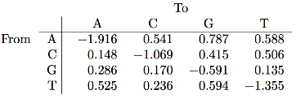
The Instantaneous-Rate Matrix
A Continuous-time Markov model is defined by a matrix of substitution rates
A table that specifies the rates of all possible changes between states.
A hypothetical instantaneous-rate matrix
This table of rates specifies the instantaneous rate of change between sates.

Slide 123
The Instantaneous-Rate Matrix
A Continuous-time Markov model is defined by a matrix of substitution rates
A table that specifies the rates of all possible changes between states.
A hypothetical instantaneous-rate matrix
This table of rates specifies the instantaneous rate of change between sates.

Slide 124
The Instantaneous-Rate Matrix
A Continuous-time Markov model is defined by a matrix of substitution rates
A table that specifies the rates of all possible changes between states.
A hypothetical instantaneous-rate matrix
This table of rates specifies the instantaneous rate of change between sates.
The rates are in terms of the expected number of substitutions per site.

Slide 125
The Instantaneous-Rate Matrix
A Continuous-time Markov model is defined by a matrix of substitution rates
A table that specifies the rates of all possible changes between states.
A hypothetical instantaneous-rate matrix
This table of rates specifies the instantaneous rate of change between sates.
The rates are in terms of the expected number of substitutions per site.
The rates are scaled so that the average rate of substitution is one.

Slide 126
The Instantaneous-Rate Matrix
A Continuous-time Markov model is defined by a matrix of substitution rates
A table that specifies the rates of all possible changes between states.
A hypothetical instantaneous-rate matrix
=
+
+
This table of rates specifies the instantaneous rate of change between sates.
The rates are in terms of the expected number of substitutions per site.
The rates are scaled so that the average rate of substitution is one.
The rows of the table must sum to zero.

Slide 127
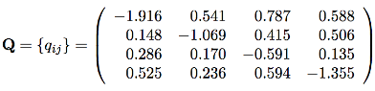
A Mechanistic Interpretation of the Rate Matrix
A hypothetical instantaneous-rate matrix
If the current state of the Markov chain is i, the next substitution will occur after an exponentially distributed waiting time with rate parameter –q_{ii}

Slide 128
A Mechanistic Interpretation of the Rate Matrix
A hypothetical instantaneous-rate matrix
If the current state of the Markov chain is i, the next substitution will occur after an exponentially distributed waiting time with rate parameter –q_{ii}
We can read this rate parameter directly from the instantaneous-rate matrix: e.g., if the current state is C, the rate parameter is –q_{CC} = –(–1.069) = 1.069

Slide 129
A Mechanistic Interpretation of the Rate Matrix
A hypothetical instantaneous-rate matrix
If the current state of the Markov chain is i, the next substitution will occur after an exponentially distributed waiting time with rate parameter –q_{ii}
We can read this rate parameter directly from the instantaneous-rate matrix: e.g., if the current state is C, the rate parameter is –q_{CC} = –(–1.069) = 1.069
or, equivalently: q_{CA} + q_{CG} + q_{CT} = 0.148 + 0.415 + 0.506 = 1.069

Slide 130
A Mechanistic Interpretation of the Rate Matrix
A hypothetical instantaneous-rate matrix
If the current state of the Markov chain is i, the next substitution will occur after an exponentially distributed waiting time with rate parameter –q_{ii}
We can read this rate parameter directly from the instantaneous-rate matrix: e.g., if the current state is C, the rate parameter is –q_{CC} = –(–1.069) = 1.069
or, equivalently: q_{CA} + q_{CG} + q_{CT} = 0.148 + 0.415 + 0.506 = 1.069
When an event occurs, the rate matrix also specifies the probabilities of all possible substitutions: P(igj) = q_{ij} ÷–q_{ii}

Slide 131
A Mechanistic Interpretation of the Rate Matrix
A hypothetical instantaneous-rate matrix
If the current state of the Markov chain is i, the next substitution will occur after an exponentially distributed waiting time with rate parameter –q_{ii}
We can read this rate parameter directly from the instantaneous-rate matrix: e.g., if the current state is C, the rate parameter is –q_{CC} = –(–1.069) = 1.069
or, equivalently: q_{CA} + q_{CG} + q_{CT} = 0.148 + 0.415 + 0.506 = 1.069
When an event occurs, the rate matrix also specifies the probabilities of all possible substitutions: P(igj) = q_{ij} ÷–q_{ii}
P(CgA) = q_{CA} /–q_{CC} = 0.148 ⎟ 1.069 = 0.138

Slide 132
A Mechanistic Interpretation of the Rate Matrix
A hypothetical instantaneous-rate matrix
If the current state of the Markov chain is i, the next substitution will occur after an exponentially distributed waiting time with rate parameter –q_{ii}
We can read this rate parameter directly from the instantaneous-rate matrix: e.g., if the current state is C, the rate parameter is –q_{CC} = –(–1.069) = 1.069
or, equivalently: q_{CA} + q_{CG} + q_{CT} = 0.148 + 0.415 + 0.506 = 1.069
When an event occurs, the rate matrix also specifies the probabilities of all possible substitutions: P(igj) = q_{ij} ÷–q_{ii}
P(CgA) = q_{CA} /–q_{CC} = 0.148 ⎟ 1.069 = 0.138

Slide 133
A Mechanistic Interpretation of the Rate Matrix
A hypothetical instantaneous-rate matrix
If the current state of the Markov chain is i, the next substitution will occur after an exponentially distributed waiting time with rate parameter –q_{ii}
We can read this rate parameter directly from the instantaneous-rate matrix: e.g., if the current state is C, the rate parameter is –q_{CC} = –(–1.069) = 1.069
or, equivalently: q_{CA} + q_{CG} + q_{CT} = 0.148 + 0.415 + 0.506 = 1.069
When an event occurs, the rate matrix also specifies the probabilities of all possible substitutions: P(igj) = q_{ij} ÷–q_{ii}
P(CgA) = q_{CA} /–q_{CC} = 0.148 ⎟ 1.069 = 0.138
P(CgG) = q_{CG} /–q_{CC} = 0.415 ⎟ 1.069 = 0.388

Slide 134
A Mechanistic Interpretation of the Rate Matrix
A hypothetical instantaneous-rate matrix
If the current state of the Markov chain is i, the next substitution will occur after an exponentially distributed waiting time with rate parameter –q_{ii}
We can read this rate parameter directly from the instantaneous-rate matrix: e.g., if the current state is C, the rate parameter is –q_{CC} = –(–1.069) = 1.069
or, equivalently: q_{CA} + q_{CG} + q_{CT} = 0.148 + 0.415 + 0.506 = 1.069
When an event occurs, the rate matrix also specifies the probabilities of all possible substitutions: P(igj) = q_{ij} ÷–q_{ii}
P(CgA) = q_{CA} /–q_{CC} = 0.148 ⎟ 1.069 = 0.138
P(CgG) = q_{CG} /–q_{CC} = 0.415 ⎟ 1.069 = 0.388
P(CgT) = q_{CT} /–q_{CC} = 0.506 ⎟ 1.069 = 0.474

Slide 135
A Mechanistic Interpretation of the Rate Matrix
A hypothetical instantaneous-rate matrix
If the current state of the Markov chain is i, the next substitution will occur after an exponentially distributed waiting time with rate parameter –q_{ii}
We can read this rate parameter directly from the instantaneous-rate matrix: e.g., if the current state is C, the rate parameter is –q_{CC} = –(–1.069) = 1.069
or, equivalently: q_{CA} + q_{CG} + q_{CT} = 0.148 + 0.415 + 0.506 = 1.069
When an event occurs, the rate matrix also specifies the probabilities of all possible substitutions: P(igj) = q_{ij} ÷–q_{ii}
P(CgA) = q_{CA} /–q_{CC} = 0.148 ⎟ 1.069 = 0.138
P(CgG) = q_{CG} /–q_{CC} = 0.415 ⎟ 1.069 = 0.388
P(CgT) = q_{CT} /–q_{CC} = 0.506 ⎟ 1.069 = 0.474
∑P_{ij} = 1.0

Slide 136
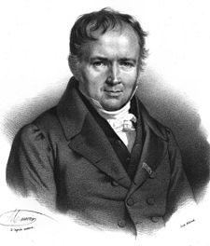
Another Probabilistic Digression
Waiting times in a Poisson process
Some rare, discrete event that occurs at a constant rate in continuous time is described by a Poisson process
Siméon Poisson (1821)

Slide 137
Another Probabilistic Digression
Waiting times in a Poisson process
Some rare, discrete event that occurs at a constant rate in continuous time is described by a Poisson process
Siméon Poisson (1821)
“Look out for that horse, stupide!”

Slide 138
Another Probabilistic Digression
Waiting times in a Poisson process
Some rare, discrete event that occurs at a constant rate in continuous time is described by a Poisson process
These events occur with a rate
Siméon Poisson (1821)
“Look out for that horse, stupide!”

Slide 139
Another Probabilistic Digression
Waiting times in a Poisson process
Some rare, discrete event that occurs at a constant rate in continuous time is described by a Poisson process
These events occur with a rate
0
time

Slide 140
Another Probabilistic Digression
Waiting times in a Poisson process
Some rare, discrete event that occurs at a constant rate in continuous time is described by a Poisson process
These events occur with a rate
0
time

Slide 141
Another Probabilistic Digression
Waiting times in a Poisson process
Some rare, discrete event that occurs at a constant rate in continuous time is described by a Poisson process
These events occur with a rate
0
time

Slide 142
Another Probabilistic Digression
Waiting times in a Poisson process
Some rare, discrete event that occurs at a constant rate in continuous time is described by a Poisson process
These events occur with a rate
0
time

Slide 143
Another Probabilistic Digression
Waiting times in a Poisson process
Some rare, discrete event that occurs at a constant rate in continuous time is described by a Poisson process
These events occur with a rate
The waiting (sojourn) time for the first event
0
time

Slide 144
Another Probabilistic Digression
Waiting times in a Poisson process
Some rare, discrete event that occurs at a constant rate in continuous time is described by a Poisson process
These events occur with a rate
The waiting (sojourn) time for the second event
0
time

Slide 145
Another Probabilistic Digression
Waiting times in a Poisson process
Some rare, discrete event that occurs at a constant rate in continuous time is described by a Poisson process
These events occur with a rate
The waiting (sojourn) time for the third event
0
time

Slide 146
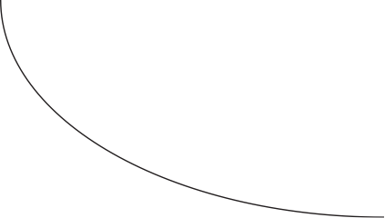
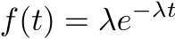
Another Probabilistic Digression
Waiting times in a Poisson process
Some rare, discrete event that occurs at a constant rate in continuous time is described by a Poisson process
These events occur with a rate
The waiting (sojourn) times are exponentially distributed random variables
probability density
time

Slide 147
Developing Intuition for CTMCs:
A Monte Carlo Simulation Experiment
What the heck is Monte Carlo Simulation?
We generate a number of replicate outcomes (we will perform multiple trials)

Slide 148
Developing Intuition for CTMCs:
A Monte Carlo Simulation Experiment
What the heck is Monte Carlo Simulation?
We generate a number of replicate outcomes (we will perform multiple trials)
of a stochastic process (our replicate experiments involve randomness)

Slide 149
Developing Intuition for CTMCs:
A Monte Carlo Simulation Experiment
What the heck is Monte Carlo Simulation?
We generate a number of replicate outcomes (we will perform multiple trials)
of a stochastic process (our replicate experiments involve randomness)
under a fully specified model (with specific values for all model parameters)

Slide 150
A Mechanistic Interpretation of the Rate Matrix
A simple Monte Carlo Simulation
We will assume that we have a fully specified phylogenetic model:

Slide 151
A Mechanistic Interpretation of the Rate Matrix
A simple Monte Carlo Simulation
We will assume that we have a fully specified phylogenetic model: there is a single branch (the tree ‘toplology')

Slide 152
A Mechanistic Interpretation of the Rate Matrix
A simple Monte Carlo Simulation
We will assume that we have a fully specified phylogenetic model: there is a single branch (the tree ‘toplology') the branch has a length of 0.5 (expected substitutions/site)
0.5
0

Slide 153
A Mechanistic Interpretation of the Rate Matrix
A simple Monte Carlo Simulation
We will assume that we have a fully specified phylogenetic model: there is a single branch (the tree ‘toplology') the branch has a length of 0.5 (expected substitutions/site) the instantaneous-rate matrix is known
0.5
0

Slide 154
A Mechanistic Interpretation of the Rate Matrix
A simple Monte Carlo Simulation
We will use a random-number generator to mimic the stochastic process:

Slide 155
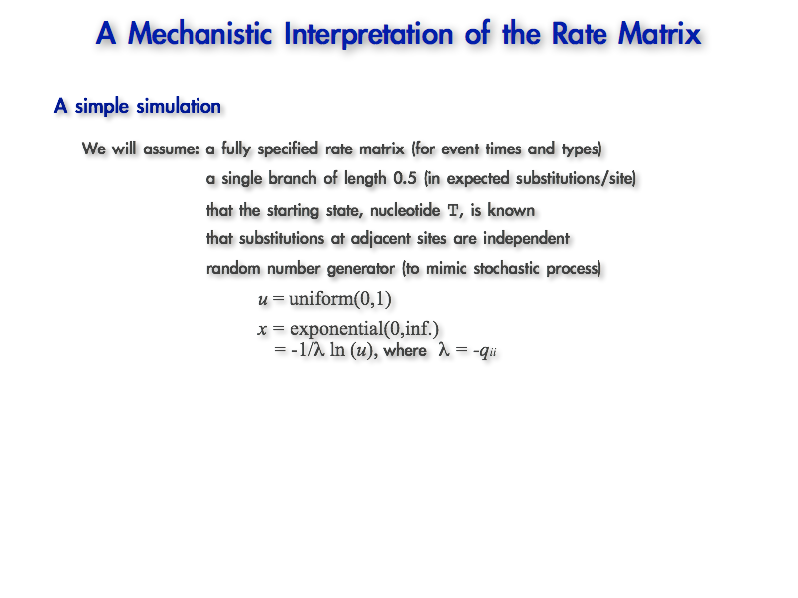
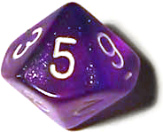
A Mechanistic Interpretation of the Rate Matrix
A high-tech, pseudo-random number generator...

Slide 156
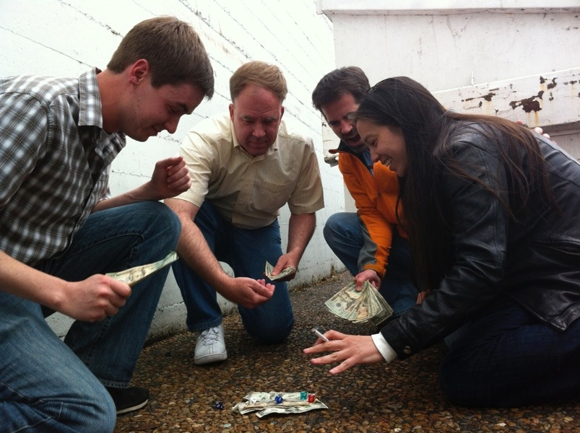
A Mechanistic Interpretation of the Rate Matrix
A high-tech, pseudo-random income generator...

Slide 157
A Mechanistic Interpretation of the Rate Matrix
A simple Monte Carlo Simulation
We will use a random-number generator to mimic the stochastic process: to generate uniformly distributed random variables, u = uniform(0,1)

Slide 158
A Mechanistic Interpretation of the Rate Matrix
A simple Monte Carlo Simulation
We will use a random-number generator to mimic the stochastic process: to generate uniformly distributed random variables, u = uniform(0,1)
The uniform probability distribution: all values u between 0 &1 are equiprobable:
probability density
0
u
1

Slide 159
A Mechanistic Interpretation of the Rate Matrix
A simple Monte Carlo Simulation
We will use a random-number generator to mimic the stochastic process: to generate uniformly distributed random variables, u = uniform(0,1)
The uniform probability distribution: all values u between 0 &1 are equiprobable:
probability density
0
u
1

Slide 160
A Mechanistic Interpretation of the Rate Matrix
A simple Monte Carlo Simulation
We will use a random-number generator to mimic the stochastic process: to generate uniformly distributed random variables, u = uniform(0,1)
The uniform probability distribution: all values u between 0 &1 are equiprobable:
probability density
0
u
1
Operationally, we can generate uniform(0,1) random variables with our die by: 1. write u = 0.

Slide 161
A Mechanistic Interpretation of the Rate Matrix
A simple Monte Carlo Simulation
We will use a random-number generator to mimic the stochastic process: to generate uniformly distributed random variables, u = uniform(0,1)
The uniform probability distribution: all values u between 0 &1 are equiprobable:
probability density
0
u
1
Operationally, we can generate uniform(0,1) random variables with our die by: 1. write u = 0. 2. roll the die and append the resulting number
u = 0.

Slide 162
A Mechanistic Interpretation of the Rate Matrix
A simple Monte Carlo Simulation
We will use a random-number generator to mimic the stochastic process: to generate uniformly distributed random variables, u = uniform(0,1)
The uniform probability distribution: all values u between 0 &1 are equiprobable:
probability density
0
u
1
Operationally, we can generate uniform(0,1) random variables with our die by: 1. write u = 0. 2. roll the die and append the resulting number
u = 0.6

Slide 163
A Mechanistic Interpretation of the Rate Matrix
A simple Monte Carlo Simulation
We will use a random-number generator to mimic the stochastic process: to generate uniformly distributed random variables, u = uniform(0,1)
The uniform probability distribution: all values u between 0 &1 are equiprobable:
probability density
0
u
1
Operationally, we can generate uniform(0,1) random variables with our die by: 1. write u = 0. 2. roll the die and append the resulting number
3. repeat for the desired precision
u = 0.62

Slide 164
A Mechanistic Interpretation of the Rate Matrix
A simple Monte Carlo Simulation
We will use a random-number generator to mimic the stochastic process: to generate uniformly distributed random variables, u = uniform(0,1)
The uniform probability distribution: all values u between 0 &1 are equiprobable:
probability density
0
u
1
Operationally, we can generate uniform(0,1) random variables with our die by: 1. write u = 0. 2. roll the die and append the resulting number
3. repeat for the desired precision
u = 0.629

Slide 165
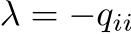
A Mechanistic Interpretation of the Rate Matrix
A simple Monte Carlo Simulation
We will use a random-number generator to mimic the stochastic process: to generate uniformly distributed random variables, u = uniform(0,1)
We will also generate exponential random variables from uniform random variables using a mathematical trick:
x = exponential(0,inf) = –1/ ln(u) where

Slide 166
A Mechanistic Interpretation of the Rate Matrix
A simple Monte Carlo Simulation
?
0.5
0
T

Slide 167
A Mechanistic Interpretation of the Rate Matrix
A simple Monte Carlo Simulation
?
0.5
Rate of leaving the current state, T = 1.355
0
T

Slide 168
A Mechanistic Interpretation of the Rate Matrix
A simple Monte Carlo Simulation
?
0.5
Probability of changing to A:
P(TgA) = q_{TA} /–q_{TT} = 0.525 ⎟ 1.355 = 0.387
0
T

Slide 169
A Mechanistic Interpretation of the Rate Matrix
A simple Monte Carlo Simulation
?
0.5
Probability of changing to C:
P(TgA) = q_{TA} /–q_{TT} = 0.525 ⎟ 1.355 = 0.387
P(TgC) = q_{TC} /–q_{TT} = 0.236 ⎟ 1.355 = 0.174
0
T

Slide 170
A Mechanistic Interpretation of the Rate Matrix
A simple Monte Carlo Simulation
?
0.5
Probability of changing to G:
P(TgA) = q_{TA} /–q_{TT} = 0.525 ⎟ 1.355 = 0.387
P(TgC) = q_{TC} /–q_{TT} = 0.236 ⎟ 1.355 = 0.174
P(TgG) = q_{TG} /–q_{TT} = 0.594 ⎟ 1.355 = 0.438
0
T

Slide 171
A Mechanistic Interpretation of the Rate Matrix
A simple Monte Carlo Simulation
?
0.5
Generate an exponentially distributed waiting time, x:
0
T

Slide 172
A Mechanistic Interpretation of the Rate Matrix
A simple Monte Carlo Simulation
?
0.5
Generate an exponentially distributed waiting time, x:
rate when process is in T:
= 1.355
0
T

Slide 173
A Mechanistic Interpretation of the Rate Matrix
A simple Monte Carlo Simulation
?
0.5
Generate an exponentially distributed waiting time, x:
rate when process is in T:
= 1.355
generate uniformly distributed random number with the die: u = 0.
0
T

Slide 174
A Mechanistic Interpretation of the Rate Matrix
A simple Monte Carlo Simulation
?
0.5
Generate an exponentially distributed waiting time, x:
rate when process is in T:
= 1.355
generate uniformly distributed random number with the die: u = 0.8
0
T

Slide 175
A Mechanistic Interpretation of the Rate Matrix
A simple Monte Carlo Simulation
?
0.5
Generate an exponentially distributed waiting time, x:
rate when process is in T:
= 1.355
generate uniformly distributed random number with the die: u = 0.83
0
T

Slide 176
A Mechanistic Interpretation of the Rate Matrix
A simple Monte Carlo Simulation
?
0.5
Generate an exponentially distributed waiting time, x:
rate when process is in T:
= 1.355
generate uniformly distributed random number with the die: u = 0.839
0
T

Slide 177
A Mechanistic Interpretation of the Rate Matrix
A simple Monte Carlo Simulation
?
0.5
Generate an exponentially distributed waiting time, x:
rate when process is in T:
= 1.355
generate uniformly distributed random number with the die: u = 0.839
x = –1/ ln(u) = 0.130
0
T

Slide 178
A Mechanistic Interpretation of the Rate Matrix
A simple Monte Carlo Simulation
?
0.5
Generate an exponentially distributed waiting time, x:
rate when process is in T:
= 1.355
generate uniformly distributed random number with the die: u = 0.839
0.130
x = –1/ ln(u) = 0.130
T
0
T

Slide 179
A Mechanistic Interpretation of the Rate Matrix
A simple Monte Carlo Simulation
?
0.5
Generate an exponentially distributed waiting time, x:
rate when process is in T:
= 1.355
generate uniformly distributed random number with the die: u = 0.839
0.130
x = –1/ ln(u) = 0.130
T
Probabilities of substitution events in state T:
0
P(TgA) = q_{TA} /–q_{TT} = 0.525 ⎟ 1.355 = 0.387
T
P(TgC) = q_{TC} /–q_{TT} = 0.236 ⎟ 1.355 = 0.174
P(TgG) = q_{TG} /–q_{TT} = 0.594 ⎟ 1.355 = 0.438

Slide 180
A Mechanistic Interpretation of the Rate Matrix
A simple Monte Carlo Simulation
?
0.5
Generate an exponentially distributed waiting time, x:
rate when process is in T:
= 1.355
generate uniformly distributed random number with the die: u = 0.839
0.130
x = –1/ ln(u) = 0.130
T
Specify a set of intervals: intervals
0
P(TgA) = 0.387 0 – 0.387 (choose A)
T
P(TgC) = 0.174 0.387 – 0.561 (choose C)
P(TgG) = 0.438 0.561 – 1 (choose G)

Slide 181
Aside: Making Decisions within Random Numbers
Only the width of the bins matters, not their order
Our uniform(0,1) random number will take any value between 0 and 1 with equal probability (by definition)
probability density
0
1

Slide 182
Aside: Making Decisions within Random Numbers
Only the width of the bins matters, not their order
Our uniform(0,1) random number will take any value between 0 and 1 with equal probability (by definition)
probability density
0
1

Slide 183
Aside: Making Decisions within Random Numbers
Only the width of the bins matters, not their order
Our uniform(0,1) random number will take any value between 0 and 1 with equal probability (by definition)
probability density
0
1
Imagine that there are two possible outcomes, A and B, which occur with probabilities:
Probability of outcomes:
P(option A) = 0.6
P(option B) = 0.4

Slide 184
Aside: Making Decisions within Random Numbers
Only the width of the bins matters, not their order
Our uniform(0,1) random number will take any value between 0 and 1 with equal probability (by definition)
probability density
0
1
Imagine that there are two possible outcomes, A and B, which occur with probabilities:
Probability of outcomes:
P(option A) = 0.6
P(option B) = 0.4
We can choose randomly (according to their probabilities) by specifying these intervals…
Probability of outcomes: intervals
P(option A) = 0.6 0.0 – 0.6 (choose A)
P(option B) = 0.4 0.6 – 1.0 (choose B)

Slide 185
Aside: Making Decisions within Random Numbers
Only the width of the bins matters, not their order
Our uniform(0,1) random number will take any value between 0 and 1 with equal probability (by definition)
probability density
choose A
choose B
0
0.6
1
Imagine that there are two possible outcomes, A and B, which occur with probabilities:
Probability of outcomes:
P(option A) = 0.6
P(option B) = 0.4
We can choose randomly (according to their probabilities) by specifying these intervals…
Probability of outcomes: intervals
P(option A) = 0.6 0.0 – 0.6 (choose A)
P(option B) = 0.4 0.6 – 1.0 (choose B)

Slide 186
Aside: Making Decisions within Random Numbers
Only the width of the bins matters, not their order
Our uniform(0,1) random number will take any value between 0 and 1 with equal probability (by definition)
probability density
choose B
choose A
0
0.4
1
Imagine that there are two possible outcomes, A and B, which occur with probabilities:
Imagine that there are two possible outcomes, A and B, which occur with probabilities:
Probability of outcomes:
P(option A) = 0.6
P(option B) = 0.4
Or equivalently by specifying these intervals…
Probability of outcomes: intervals
P(option A) = 0.6 0.4 – 1.0 (choose A)
P(option B) = 0.4 0.0 – 0.6 (choose B)

Slide 187
A Mechanistic Interpretation of the Rate Matrix
A simple Monte Carlo Simulation
?
0.5
Generate an exponentially distributed waiting time, x:
rate when process is in T:
= 1.355
generate uniformly distributed random number with the die: u = 0.839
0.130
x = –1/ ln(u) = 0.130
T
Specify a set of intervals: intervals
0
P(TgA) = 0.387 0 – 0.387 (choose A)
T
P(TgC) = 0.174 0.387 – 0.561 (choose C)
P(TgG) = 0.438 0.561 – 1 (choose G)

Slide 188
A Mechanistic Interpretation of the Rate Matrix
A simple Monte Carlo Simulation
?
0.5
Generate an exponentially distributed waiting time, x:
rate when process is in T:
= 1.355
generate uniformly distributed random number with the die: u = 0.839
0.130
x = –1/ ln(u) = 0.130
T
Specify a set of intervals: intervals
0
P(TgA) = 0.387 0 – 0.387 (choose A)
T
P(TgC) = 0.174 0.387 – 0.561 (choose C)
P(TgG) = 0.438 0.561 – 1 (choose G)
Generate a new uniformly distributed number, u, to select substitution event
0.
4
4
6

Slide 189
A Mechanistic Interpretation of the Rate Matrix
A simple Monte Carlo Simulation
?
0.5
Generate an exponentially distributed waiting time, x:
rate when process is in T:
= 1.355
generate uniformly distributed random number with the die: u = 0.839
0.130
x = –1/ ln(u) = 0.130
T
Specify a set of intervals: intervals
0
P(TgA) = 0.387 0 – 0.387 (choose A)
T
P(TgC) = 0.174 0.387 – 0.561 (choose C)
P(TgG) = 0.438 0.561 – 1 (choose G)
Generate a new uniformly distributed number, u, to select substitution event

Slide 190
A Mechanistic Interpretation of the Rate Matrix
A simple Monte Carlo Simulation
?
0.5
0.130
T
0
T

Slide 191
A Mechanistic Interpretation of the Rate Matrix
A simple Monte Carlo Simulation
?
0.5
Generate waiting time to next event:
in state C: –q_{CC}=
= 1.069
0.130
T
0
T

Slide 192
A Mechanistic Interpretation of the Rate Matrix
A simple Monte Carlo Simulation
?
0.5
Generate waiting time to next event:
in state C: –q_{CC}=
= 1.069
u = uniform(0,1) = …
0.130
T
0
T
0.
9
2
2

Slide 193
A Mechanistic Interpretation of the Rate Matrix
A simple Monte Carlo Simulation
?
0.5
Generate waiting time to next event:
in state C: –q_{CC}=
= 1.069
u = uniform(0,1) = 0.922
0.130
x = –1/ ln(u) = 0.076
T
0
T

Slide 194
A Mechanistic Interpretation of the Rate Matrix
A simple Monte Carlo Simulation
?
0.5
Generate waiting time to next event:
in state C: –q_{CC}=
= 1.069
0.206
u = uniform(0,1) = 0.922
C
0.130
x = –1/ ln(u) = 0.076
T
0
T

Slide 195
A Mechanistic Interpretation of the Rate Matrix
A simple Monte Carlo Simulation
?
0.5
Generate waiting time to next event:
in state C: –q_{CC}=
= 1.069
0.206
u = uniform(0,1) = 0.922
C
0.130
x = –1/ ln(u) = 0.076
T
Substitution probabilities in state C:
0
P(CgA) = q_{CA} /–q_{CC} = 0.148 ⎟ 1.069 = 0.138
T

Slide 196
A Mechanistic Interpretation of the Rate Matrix
A simple Monte Carlo Simulation
?
0.5
Generate waiting time to next event:
in state C: –q_{CC}=
= 1.069
0.206
u = uniform(0,1) = 0.922
C
0.130
x = –1/ ln(u) = 0.076
T
Substitution probabilities in state C:
0
P(CgA) = q_{CA} /–q_{CC} = 0.148 ⎟ 1.069 = 0.138
T
P(CgG) = q_{CG} /–q_{CC} = 0.415 ⎟ 1.069 = 0.388

Slide 197
A Mechanistic Interpretation of the Rate Matrix
A simple Monte Carlo Simulation
?
0.5
Generate waiting time to next event:
in state C: –q_{CC}=
= 1.069
0.206
u = uniform(0,1) = 0.922
C
0.130
x = –1/ ln(u) = 0.076
T
Substitution probabilities in state C:
0
P(CgA) = q_{CA} /–q_{CC} = 0.148 ⎟ 1.069 = 0.138
T
P(CgG) = q_{CG} /–q_{CC} = 0.415 ⎟ 1.069 = 0.388
P(CgT) = q_{CT} /–q_{CC} = 0.506 ⎟ 1.069 = 0.474

Slide 198
A Mechanistic Interpretation of the Rate Matrix
A simple Monte Carlo Simulation
?
0.5
Generate waiting time to next event:
in state C: –q_{CC}=
= 1.069
0.206
u = uniform(0,1) = 0.922
C
0.130
x = –1/ ln(u) = 0.076
T
Specify a set of intervals: intervals
0
P(CgA) = 0.138 0 – 0.138
(choose A)
T
P(CgG) = 0.388 0.138 – 0.526
(choose G)
P(CgT) = 0.474 0.526 – 1
(choose T)

Slide 199
A Mechanistic Interpretation of the Rate Matrix
A simple Monte Carlo Simulation
?
0.5
Generate waiting time to next event:
in state C: –q_{CC}=
= 1.069
0.206
u = uniform(0,1) = 0.922
C
0.130
x = –1/ ln(u) = 0.076
T
Specify a set of intervals: intervals
0
P(CgA) = 0.138 0 – 0.138
(choose A)
T
P(CgG) = 0.388 0.138 – 0.526
(choose G)
P(CgT) = 0.474 0.526 – 1
(choose T)
Generate a new uniformly distributed number, u, to select substitution event
0.
3
1
7

Slide 200
A Mechanistic Interpretation of the Rate Matrix
A simple Monte Carlo Simulation
?
0.5
Generate waiting time to next event:
in state C: –q_{CC}=
= 1.069
0.206
u = uniform(0,1) = 0.922
C
0.130
x = –1/ ln(u) = 0.076
T
Specify a set of intervals: intervals
0
P(CgA) = 0.138 0 – 0.138
(choose A)
T
P(CgG) = 0.388 0.138 – 0.526
(choose G)
P(CgT) = 0.474 0.526 – 1
(choose T)
Generate a new uniformly distributed number, u, to select substitution event

Slide 201
A Mechanistic Interpretation of the Rate Matrix
A simple Monte Carlo Simulation
?
0.5
0.206
C
0.130
T
0
T

Slide 202
A Mechanistic Interpretation of the Rate Matrix
A simple Monte Carlo Simulation
?
0.5
Generate waiting time to next event:
in state G: –q_{GG}=
= 0.591
0.206
C
0.130
T
0
T

Slide 203
A Mechanistic Interpretation of the Rate Matrix
A simple Monte Carlo Simulation
?
0.5
Generate waiting time to next event:
in state G: –q_{GG}=
= 0.591
0.206
u = uniform(0,1) = 0.341
C
0.130
T
0
T

Slide 204
A Mechanistic Interpretation of the Rate Matrix
A simple Monte Carlo Simulation
?
0.5
Generate waiting time to next event:
in state G: –q_{GG}=
= 0.591
0.206
u = uniform(0,1) = 0.341
C
0.130
x = –1/ ln(u) = 1.820
T
0
T

Slide 205
A Mechanistic Interpretation of the Rate Matrix
A simple Monte Carlo Simulation
G
0.5
Generate waiting time to next event:
in state G: –q_{GG}=
= 0.591
0.206
u = uniform(0,1) = 0.341
C
0.130
x = –1/ ln(u) = 1.820
T
Terminate simulation (in state G)
0
T

Slide 206
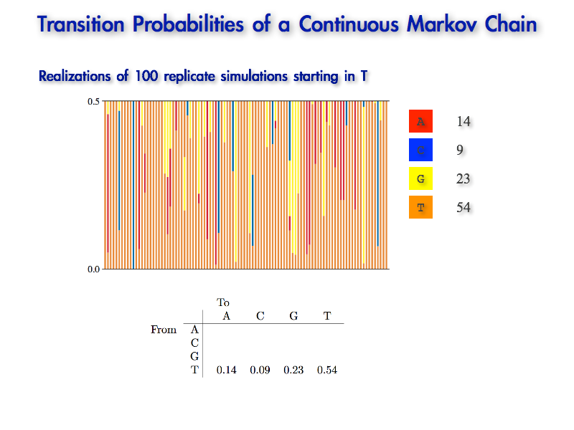
Transition Probabilities of a CTMC
Estimating transition probabilities using Monte Carlo simulation

Slide 207
Transition Probabilities of a CTMC
Estimating transition probabilities using Monte Carlo simulation

Slide 208
Transition Probabilities of a CTMC
Estimating transition probabilities using Monte Carlo simulation
T C G
Ended in G with two changes

Slide 209
Transition Probabilities of a CTMC
Estimating transition probabilities using Monte Carlo simulation
T C G
Ended in G with two changes

Slide 210
Transition Probabilities of a CTMC
Estimating transition probabilities using Monte Carlo simulation
1
T C G
Ended in G with two changes

Slide 211
Transition Probabilities of a CTMC
Estimating transition probabilities using Monte Carlo simulation
2
T A G
Ended in G with two changes

Slide 212
Transition Probabilities of a CTMC
Estimating transition probabilities using Monte Carlo simulation
3
T C G
Ended in G with two changes

Slide 213
Transition Probabilities of a CTMC
Estimating transition probabilities using Monte Carlo simulation
4
T G
Ended in G with one change

Slide 214
Transition Probabilities of a CTMC
Estimating transition probabilities using Monte Carlo simulation
5
T G
Ended in G with one change

Slide 215
Transition Probabilities of a CTMC
Estimating transition probabilities using Monte Carlo simulation
6
T A G
Ended in G with two changes

Slide 216
Transition Probabilities of a CTMC
Estimating transition probabilities using Monte Carlo simulation
7
T A G
Ended in G with two changes

Slide 217
Transition Probabilities of a CTMC
Estimating transition probabilities using Monte Carlo simulation
8
T G
Ended in G with one change

Slide 218
Transition Probabilities of a CTMC
Estimating transition probabilities using Monte Carlo simulation
9
T G
Ended in G with one change

Slide 219
Transition Probabilities of a CTMC
Estimating transition probabilities using Monte Carlo simulation
10
T G
Ended in G with one change

Slide 220
Transition Probabilities of a CTMC
Estimating transition probabilities using Monte Carlo simulation
11
T G
Ended in G with one change

Slide 221
Transition Probabilities of a CTMC
Estimating transition probabilities using Monte Carlo simulation
12
T G
Ended in G with one change

Slide 222
Transition Probabilities of a CTMC
Estimating transition probabilities using Monte Carlo simulation
13
T G
Ended in G with one change

Slide 223
Transition Probabilities of a CTMC
Estimating transition probabilities using Monte Carlo simulation
14
T G
Ended in G with one change

Slide 224
Transition Probabilities of a CTMC
Estimating transition probabilities using Monte Carlo simulation
15
Ended in G with one change

Slide 225
Transition Probabilities of a CTMC
Estimating transition probabilities using Monte Carlo simulation
16
T A G
Ended in G with two changes

Slide 226
Transition Probabilities of a CTMC
Estimating transition probabilities using Monte Carlo simulation
17
T G
Ended in G with one change

Slide 227
Transition Probabilities of a CTMC
Estimating transition probabilities using Monte Carlo simulation
18
T G
Ended in G with one change

Slide 228
Transition Probabilities of a CTMC
Estimating transition probabilities using Monte Carlo simulation
19
T G
Ended in G with one change

Slide 229
Transition Probabilities of a CTMC
Estimating transition probabilities using Monte Carlo simulation
20
T G
Ended in G with one change

Slide 230
Transition Probabilities of a CTMC
Estimating transition probabilities using Monte Carlo simulation
21
T G
Ended in G with one change

Slide 231
Transition Probabilities of a CTMC
Estimating transition probabilities using Monte Carlo simulation
22
T G
Ended in G with one change

Slide 232
Transition Probabilities of a CTMC
Estimating transition probabilities using Monte Carlo simulation
23
T G
Ended in G with one change

Slide 233
Transition Probabilities of a CTMC
Estimating transition probabilities using Monte Carlo simulation
23
What is the probability that the process ends in G given that we started in T (and given the other parameters of the model)?

Slide 234
Transition Probabilities of a CTMC
Estimating transition probabilities using Monte Carlo simulation
number of
outcomes
23
What is the probability that the process ends in G given that we started in T (and given the other parameters of the model)?

Slide 235
Transition Probabilities of a CTMC
Estimating transition probabilities using Monte Carlo simulation
number of
outcomes
23 ÷ 100
number of
simulations
What is the probability that the process ends in G given that we started in T (and given the other parameters of the model)?

Slide 236
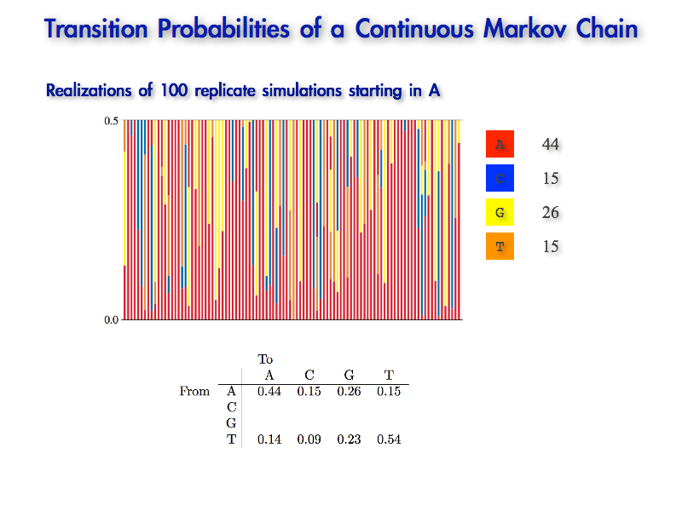
Transition Probabilities of a CTMC
Estimating transition probabilities using Monte Carlo simulation
number of
outcomes
23 ÷ 100
number of
simulations
What is the probability that the process ends in G given that we started in T (and given the other parameters of the model)?

Slide 237
Transition Probabilities of a CTMC
Estimating transition probabilities using Monte Carlo simulation
number of
outcomes
23 ÷ 100
number of
simulations
This ‘transition probability’ reflects all possible histories that start in T and end in G (i.e., histories with different numbers and/or positions of changes)

Slide 238
Transition Probabilities of a CTMC
Estimating transition probabilities using Monte Carlo simulation
14
23
We can repeat this process for the other end states…

Slide 239
Transition Probabilities of a CTMC
Estimating transition probabilities using Monte Carlo simulation
14
09
23
We can repeat this process for the other end states…

Slide 240
Transition Probabilities of a CTMC
Estimating transition probabilities using Monte Carlo simulation
14
09
23
54
We can repeat this process for the other end states…

Slide 241
Transition Probabilities of a CTMC
Estimating transition probabilities using Monte Carlo simulation
14
09
23
54
+
+
+
= 1
Note that each row of the transition-probability matrix sums to 1 (c.f., the Law of Total Probability).

Slide 242
Transition Probabilities of a CTMC
Realizations of 100 replicate simulations starting in state A
44
15
26
15
We could perform new Monte Carlo simulations that start in A to fill out the corresponding row of the transition-probability matrix.

Slide 243
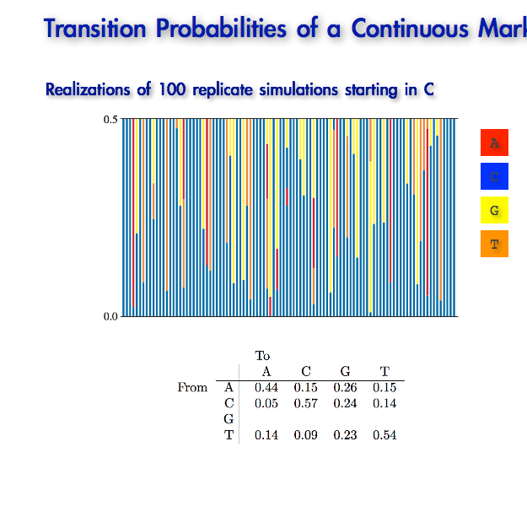
Transition Probabilities of a CTMC
Realizations of 100 replicate simulations starting in state C
05
57
24
14
And then for simulations that start in C …

Slide 244
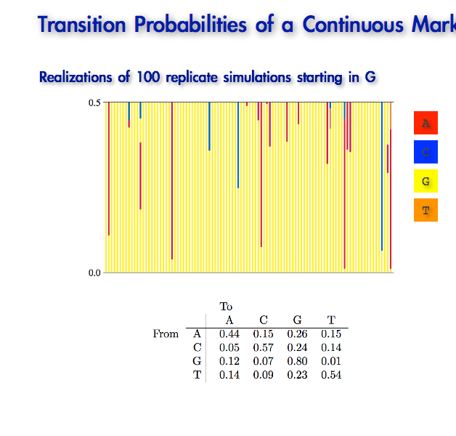
Transition Probabilities of a CTMC
Realizations of 100 replicate simulations starting in state G
12
07
80
01
And finally for simulations that start in G.

Slide 245
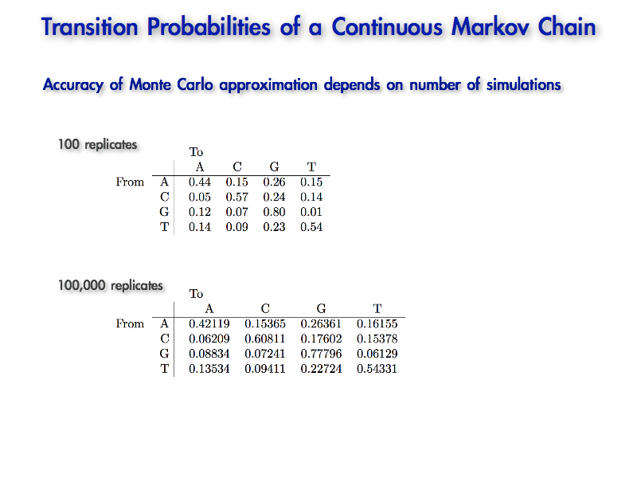
Transition Probabilities of a CTMC
Accuracy of Monte Carlo approximation depends on the number of replicates
100 replicates

Slide 246
Transition Probabilities of a CTMC
Accuracy of Monte Carlo approximation depends on the number of replicates
100 replicates
100,000 replicates

Slide 247
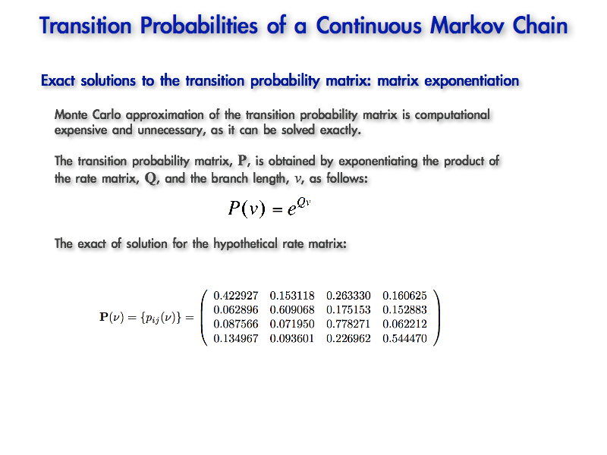
Transition Probabilities of a CTMC
Exact solutions for the transition probabilities: matrix exponentiation
Monte Carlo simulation is computationally expensive and unnecessary, as the transition probabilities can be solved 'exactly'

Slide 248
Transition Probabilities of a CTMC
Exact solutions for the transition probabilities: matrix exponentiation
Monte Carlo simulation is computationally expensive and unnecessary, as the transition probabilities can be solved 'exactly'
The transition probability matrix, P, can be solved by exponentiating the product of the instantaneous-rate matrix, Q, and the branch length, v: P(v) = e^{Qv}

Slide 249
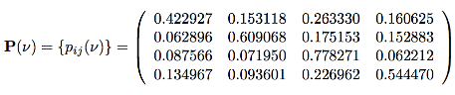
Transition Probabilities of a CTMC
Exact solutions for the transition probabilities: matrix exponentiation
Monte Carlo simulation is computationally expensive and unnecessary, as the transition probabilities can be solved 'exactly'
The transition probability matrix, P, can be solved by exponentiating the product of the instantaneous-rate matrix, Q, and the branch length, v: P(v) = e^{Qv}
The exact solution for the transition probability matrix for our instantaneous-rate matrix and branch length (0.5) is:

Slide 250
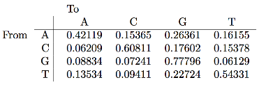
Transition Probabilities of a CTMC
Exact solutions for the transition probabilities: matrix exponentiation
Monte Carlo simulation is computationally expensive and unnecessary, as the transition probabilities can be solved 'exactly'
The transition probability matrix, P, can be solved by exponentiating the product of the instantaneous-rate matrix, Q, and the branch length, v: P(v) = e^{Qv}
The exact solution for the transition probability matrix for our instantaneous-rate matrix and branch length (0.5) is:
Compare with approximate solution (based on 100,000 replicates)

Slide 251
Transition Probabilities of a Continuous Markov Chain
By ‘exact’ I mean ‘approximate’
The matrix of transition probabilities, P(v), is obtained from the solution of the matrix of differential equations P’(v) = P(v)Q as P(v) = e^{Qv}

Slide 252
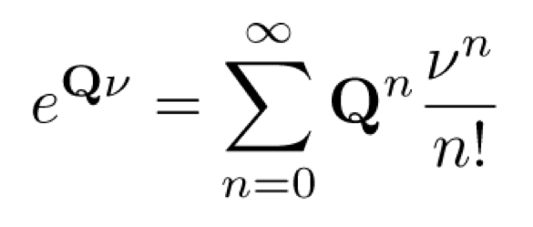
Transition Probabilities of a Continuous Markov Chain
By ‘exact’ I mean ‘approximate’
The matrix of transition probabilities, P(v), is obtained from the solution of the matrix of differential equations P’(v) = P(v)Q as P(v) = e^{Qv}
A simple (but problematic) method for computing the matrix exponential is to use the definition of the matrix exponential as the convergent series

Slide 253
Transition Probabilities of a Continuous Markov Chain
By ‘exact’ I mean ‘approximate’
The matrix of transition probabilities, P(v), is obtained from the solution of the matrix of differential equations P’(v) = P(v)Q as P(v) = e^{Qv}
A simple (but problematic) method for computing the matrix exponential is to use the definition of the matrix exponential as the convergent series
Rounding error on the matrix power causes inaccurate numerical estimates

Slide 254
Transition Probabilities of a Continuous Markov Chain
By ‘exact’ I mean ‘approximate’
The matrix of transition probabilities, P(v), is obtained from the solution of the matrix of differential equations P’(v) = P(v)Q as P(v) = e^{Qv}
A simple (but problematic) method for computing the matrix exponential is to use the definition of the matrix exponential as the convergent series
Rounding error on the matrix power causes inaccurate numerical estimates
A large (infinite) number of terms from the infinite series need to be calculated

Slide 255
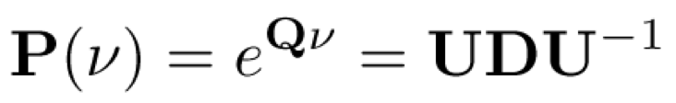
Transition Probabilities of a Continuous Markov Chain
By ‘exact’ I mean ‘approximate’
The matrix of transition probabilities, P(v), is obtained from the solution of the matrix of differential equations P’(v) = P(v)Q as P(v) = e^{Qv}
A common method for computing the matrix exponential is to use the spectral decomposition of the instantaneous rate matrix, Q:

Slide 256
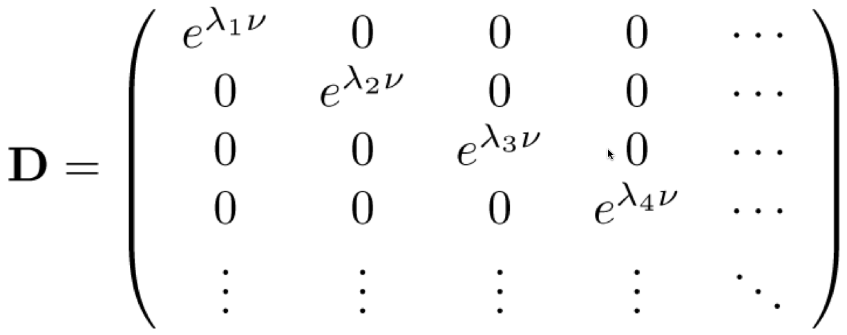
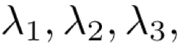
Transition Probabilities of a Continuous Markov Chain
By ‘exact’ I mean ‘approximate’
The matrix of transition probabilities, P(v), is obtained from the solution of the matrix of differential equations P’(v) = P(v)Q as P(v) = e^{Qv}
A common method for computing the matrix exponential is to use the spectral decomposition of the instantaneous rate matrix, Q:
where U is the matrix of eigenvectors of Q, and D is a diagonal matrix:
where ... are eigenvalues of Q.

Slide 257
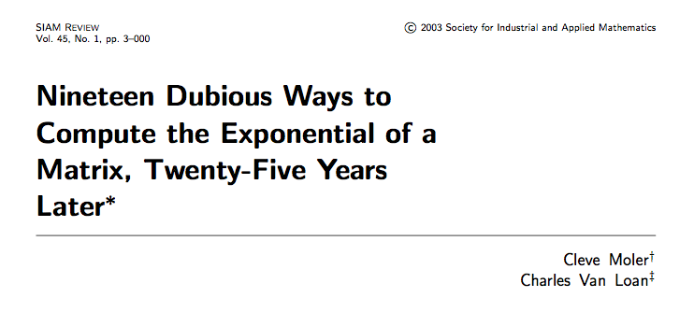
Transition Probabilities of a CTMC
Exact solutions for the transition probabilities: matrix exponentiation
Monte Carlo simulation is computationally expensive and unnecessary, as the transition probabilities can be solved 'exactly'
The transition probability matrix, P, can be solved by exponentiating the product of the instantaneous-rate matrix, Q, and the branch length, v: P(v) = e^{Qv}
The exact solution for the transition probability matrix for our instantaneous-rate matrix and branch length (0.5) is:
Compare with approximate solution (based on 100,000 replicates)

Slide 258
Transition Probabilities of a CTMC
An aside about transition probabilities
Transition probabilities account for all possible histories that a CTMC can end in a particular state, given a particular starting state (and fully specified model)

Slide 259
Transition Probabilities of a CTMC
An aside about transition probabilities
Transition probabilities account for all possible histories that a CTMC can end in a particular state, given a particular starting state (and fully specified model)
Transition probabilities play a key role in computing the likelihood, as they avoid the need to condition on a particular history of character change (nucleotide substitution)

Slide 260
Stationary Frequencies of a CTMC
Transition probabilities
The probability of observing state j conditioned on starting in state i and running the process over a branch of length v; i.e., pij(v)
Can be estimated by Monte Carlo simulation or matrix exponentiation, P(v) = e^{Qv}

Slide 261
Stationary Frequencies of a CTMC
Transition probabilities
The probability of observing state j conditioned on starting in state i and running the process over a branch of length v; i.e., pij(v)
Can be estimated by Monte Carlo simulation or matrix exponentiation, P(v) = e^{Qv}
Stationary frequencies
The long-term probability of observing the process in state j

Slide 262
Stationary Frequencies of a CTMC
Transition probabilities
The probability of observing state j conditioned on starting in state i and running the process over a branch of length v; i.e., pij(v)
Can be estimated by Monte Carlo simulation or matrix exponentiation, P(v) = e^{Qv}
Stationary frequencies
The long-term probability of observing the process in state j
Our hypothetical rate matrix:

Slide 263
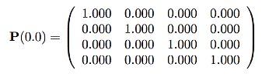
Stationary Frequencies of a CTMC
Transition probabilities
The probability of observing state j conditioned on starting in state i and running the process over a branch of length v; i.e., pij(v)
Can be estimated by Monte Carlo simulation or matrix exponentiation, P(v) = e^{Qv}
Stationary frequencies
The long-term probability of observing the process in state j
Our hypothetical rate matrix:
Transition probabilities over a branch of length v = 0.0:

Slide 264
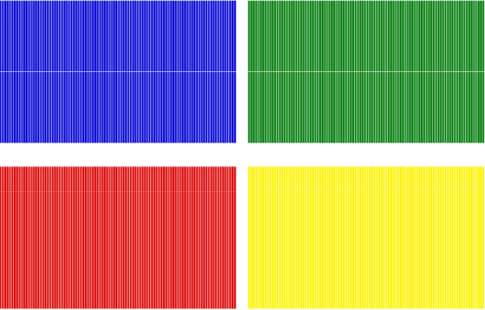
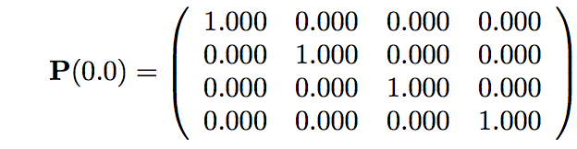
Stationary Frequencies of a CTMC

Slide 265
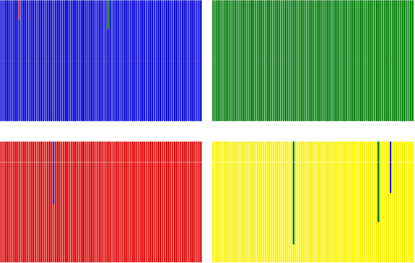
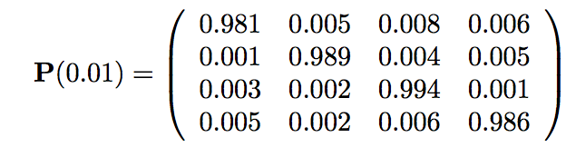
Stationary Frequencies of a CTMC

Slide 266
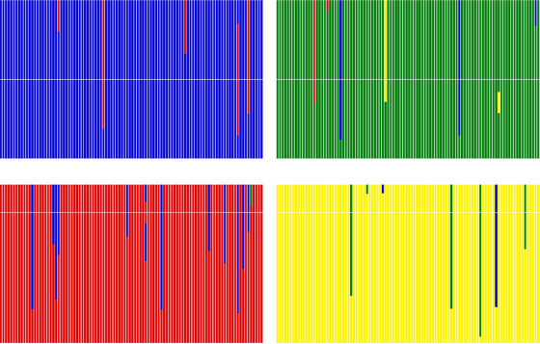
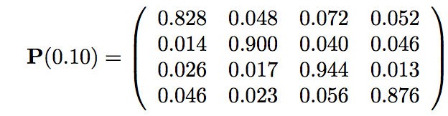
Stationary Frequencies of a CTMC

Slide 267
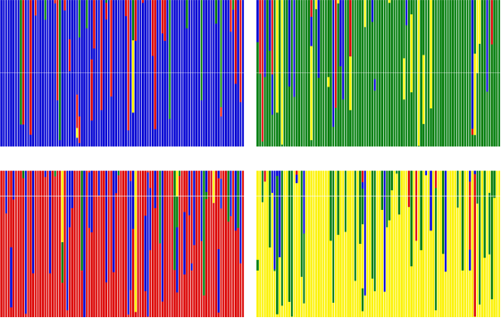

Stationary Frequencies of a CTMC

Slide 268


Stationary Frequencies of a CTMC

Slide 269


Stationary Frequencies of a CTMC

Slide 270


Stationary Frequencies of a CTMC

Slide 271


Stationary Frequencies of a CTMC

Slide 272


Slide 273
Stationary Frequencies of a CTMC
Stationary frequencies
The probability of observing the process in a particular state j after a long (infinite) period of time

Slide 274
Stationary Frequencies of a CTMC
Stationary frequencies
The probability of observing the process in a particular state j after a long (infinite) period of time
Also referred to as the 'invariant distribution' , 'stationary distribution' , 'stationary probabilities' , 'prior probabilities'

Slide 275
Stationary Frequencies of a CTMC
Stationary frequencies
The probability of observing the process in a particular state j after a long (infinite) period of time
Also referred to as the 'invariant distribution' , 'stationary distribution' , 'stationary probabilities' , 'prior probabilities'
When the continuous time Markov chain is at stationarity, the stochastic process has 'forgotten' the starting state: the process ends in a given state with the same probability, regardless of the starting state

Slide 276
Putting It All Together…
j
i
Tah-DA!!
Stationary frequencies
Transition probabilities

Slide 277
Stochastic Mechanisms of Character Change
Continuous-time Markov models
describe the stochastic process by which traits (nucleotides) evolve over the tree

Slide 278
Stochastic Mechanisms of Character Change
Continuous-time Markov models
describe the stochastic process by which traits (nucleotides) evolve over the tree
Instantaneous-rate matrix, Q
completely describes the stochastic process by specifying:

Slide 279
Stochastic Mechanisms of Character Change
Continuous-time Markov models
describe the stochastic process by which traits (nucleotides) evolve over the tree
Instantaneous-rate matrix, Q
completely describes the stochastic process by specifying:
Transition probabilities: pij(v), the probability of observing state j conditioned on starting in state i and running the process over a branch of length v
can be estimated by Monte Carlo simulation or matrix exponentiation, P(v) = e^{Qv}

Slide 280
Stochastic Mechanisms of Character Change
Continuous-time Markov models
describe the stochastic process by which traits (nucleotides) evolve over the tree
Instantaneous-rate matrix, Q
completely describes the stochastic process by specifying:
Transition probabilities: pij(v), the probability of observing state j conditioned on starting in state i and running the process over a branch of length v
can be estimated by Monte Carlo simulation or matrix exponentiation, P(v) = e^{Qv}
Stationary frequencies: the long-term probability of observing the chain in state j

Slide 281

Stochastic Mechanisms of Character Change
Instantaneous-rate matrix, Q, and the transition probability matrix, P
The instantaneous rate matrix describes the probability of change between each state in an infinitesimal time interval, qij(∂t)

Slide 282

Stochastic Mechanisms of Character Change
Instantaneous-rate matrix, Q, and the transition probability matrix, P
The instantaneous rate matrix describes the probability of change between each state in an infinitesimal time interval, qij(∂t)
The transition probability matrix, P(v) ={pij(v)}, describes the probability of observing state j given that we started in state i and ran the process over a branch of length v

Slide 283
Stochastic Mechanisms of Character Change
Instantaneous-rate matrix, Q, and the transition probability matrix, P
The instantaneous rate matrix describes the probability of change between each state in an infinitesimal time interval, qij(∂t)
The transition probability matrix, P(v) ={pij(v)}, describes the probability of observing state j given that we started in state i and ran the process over a branch of length v
The relationship between Q and P is P(v) = e^{Qv}
the transition probabilities integrate over all possible histories by which an initial state i can give rise to an end state j over branch length v

Slide 284
Statistical Estimation of Phylogeny: An Outline
Inference Method
Data
Model
Parameter
Estimates
sequence
alignment
tree with
branch lengths
maximum likelihood
phylogeny & other model parameters
substitution
model
Bayesian inference

Slide 285
Statistical Estimation of Phylogeny: An Outline
Inference Method
Data
Model
Parameter
Estimates
sequence
alignment
tree with
branch lengths
maximum likelihood
phylogeny & other model parameters
substitution
model
Bayesian inference
Next time!!

Slide 286

Scaling the Instantaneous Rate Matrix

Slide 287
Scaling the Instantaneous Rate Matrix

Slide 288
Scaling the Instantaneous Rate Matrix

Slide 289

Scaling the Instantaneous Rate Matrix

Slide 290
Scaling the Instantaneous Rate Matrix

Slide 291
Scaling the Instantaneous Rate Matrix

Slide 292
Scaling the Instantaneous Rate Matrix

Slide 293
Scaling the Instantaneous Rate Matrix

Slide 294

Scaling the Instantaneous Rate Matrix
Let’s check the scaling of our hypothetical rate matrix
The instantaneous rate matrix...
Stationary frequencies...
The average substitution rate...

Slide 295
Scaling the Instantaneous Rate Matrix
Let’s check the scaling of our hypothetical rate matrix
The instantaneous rate matrix...
Stationary frequencies...
The average substitution rate...

Slide 296
Scaling the Instantaneous Rate Matrix
Let’s check the scaling of our hypothetical rate matrix
The instantaneous rate matrix...
Stationary frequencies...
The (weighted) average substitution rate...

Slide 297

Scaling the Instantaneous Rate Matrix
Can we correctly estimate the true branch length used in our simulation?
The weighted sum of the average (expected) number of changes for all four states...
Where zi is the average number of changes observed for simulations that began in state i, and πi is the stationary frequency for state i

